Slide 1
Test #3 - Nuclear Chemistry
All open response questions
Chem Honors test: 45 questions
Chem test: 30 questions
In-class test preparation
Review of Practice Problems
Cold Call
Exact date to be determined

Slide 2
Nuclear Fission & Fusion
Write this in your notes
SWBAT explain the concepts and applications of nuclear fission and fusion, and write balanced equations for each.

Slide 3
Outline
Nature of Fission & Fusion
Applications of Fission & Fusion
Balanced Nuclear Equations

Slide 4
Outline
Nature of Fission & Fusion
Applications of Fission & Fusion
Balanced Nuclear Equations

Slide 5
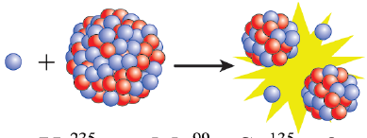
Three Types of Nuclear Reactions
REVIEW
Radioactive Decay - a process by which a nucleus spontaneously changes itself by emitting particles or energy.
Nuclear Fission - a process by which a nucleus splits into two or more smaller parts
Nuclear fusion - a process by which two nuclei join together into one larger atom

Slide 6
Summary
Write this in your notes
Characteristic | Radioactive Decay | Fission | Fusion
Starting Material(s) | 1 parent | 1 parent (trigger particle) | 2 parents (trigger conditions)
Product(s) | 1 daughter radiation | 2 daughters (more trigger particles) (radiation) | 1 daughter with larger A (other nuclei) (radiation)
Trigger | Spontaneous | Trigger (usually bombardment) | Trigger (usually extreme heat or pressure)
Objective | Improve n/p, o/e or Z>82 | Increase nuclear binding energy | Increase nuclear binding energy

Slide 7
Radioactive Decay
Radioactive Decay - a process by which a nucleus spontaneously changes itself by emitting particles or energy.
Characteristic | Radioactive Decay | Fission | Fusion
Starting Material(s)
Product(s)

Slide 8
Radioactive Decay
Write this in your notes
Radioactive Decay - a process by which a nucleus spontaneously changes itself by emitting particles or energy.
Characteristic | Radioactive Decay | Fission | Fusion
Starting Material(s) | 1 parent
Product(s) | 1 daughter radiation

Slide 9
Nuclear Fission
Nuclear Fission - a process by which a nucleus splits into two or more smaller parts
Characteristic | Radioactive Decay | Fission | Fusion
Starting Material(s) | 1 parent
Product(s) | 1 daughter radiation

Slide 10
Nuclear Fission
Write this in your notes
Nuclear Fission - a process by which a nucleus splits into two or more smaller parts
Characteristic | Radioactive Decay | Fission | Fusion
Starting Material(s) | 1 parent | 1 parent (trigger particle)
Product(s) | 1 daughter radiation | 2 daughters (more trigger particles) (radiation)

Slide 11
Nuclear Fusion
Nuclear fusion - a process by which two nuclei join together into one larger atom
Characteristic | Radioactive Decay | Fission | Fusion
Starting Material(s) | 1 parent | 1 parent (trigger particle)
Product(s) | 1 daughter radiation | 2 daughters (more trigger particles) (radiation)

Slide 12
Nuclear Fusion
Write this in your notes
Nuclear fusion - a process by which two nuclei join together into one larger atom
Characteristic | Radioactive Decay | Fission | Fusion
Starting Material(s) | 1 parent | 1 parent (trigger particle) | 2 parents (trigger conditions)
Product(s) | 1 daughter radiation | 2 daughters (more trigger particles) (radiation) | 1 daughter with larger A (other nuclei) (radiation)

Slide 13
Different Triggers
Radioactive decay
a spontaneous process – no trigger needed
caused by inherent instability of the nuclide
Nuclear fission and fusion
not spontaneous processes
the parent nuclide is often stable or has a long half-life
the reaction is triggered by an action making the parent nuclide unstable
in fission, the trigger is usually bombardment with a particle
in fusion, the trigger is usually extreme heat and pressure

Slide 14
Summary
Write this in your notes
Characteristic | Radioactive Decay | Fission | Fusion
Starting Material(s) | 1 parent | 1 parent (trigger particle) | 2 parents (trigger conditions)
Product(s) | 1 daughter radiation | 2 daughters (more trigger particles) (radiation) | 1 daughter with larger A (other nuclei) (radiation)
Trigger | Spontaneous | Trigger (usually bombardment) | Trigger (usually extreme heat or pressure)
Objective

Slide 15
Different Objectives
Radioactive decay
a nuclide decays in order to become more stable
this means optimizing n/p ratio, o/e status or Z
Nuclear fission and fusion
once fission or fusion is triggered, the nuclide also seeks to become more stable
this involves maximizing the nuclear binding energy

Slide 16
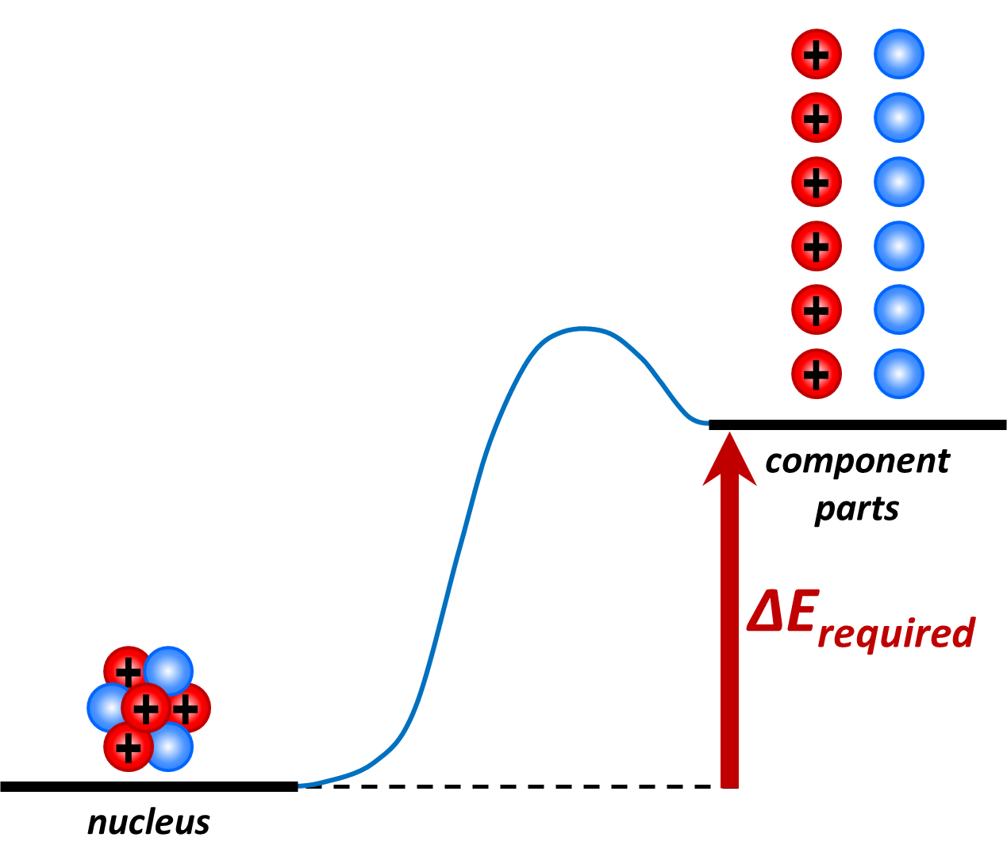
What is nuclear binding energy?
Nuclear Binding Energy - The energy required to split the nucleus of an atom into its component parts (e.g protons and neutrons)
Write this in your notes
The amount of energy required is directly related to the stability of the nucleus
larger E = more stable
smaller E = less stable

Slide 17
Summary
Write this in your notes
Characteristic | Radioactive Decay | Fission | Fusion
Starting Material(s) | 1 parent | 1 parent (trigger particle) | 2 parents (trigger conditions)
Product(s) | 1 daughter radiation | 2 daughters (more trigger particles) (radiation) | 1 daughter with larger A (other nuclei) (radiation)
Trigger | Spontaneous | Trigger (usually bombardment) | Trigger (usually extreme heat or pressure)
Objective | Improve n/p, o/e or Z>82 | Increase nuclear binding energy | Increase nuclear binding energy

Slide 18
Choosing Fission or Fusion
Write this in your notes
The maximum nuclear binding energy is achieved when the mass number is 60 (Fe, Co, Ni)
Nuclides with a mass number < 60 generally favor fusion to get closer to 60
Nuclides with a mass number > 60 generally favor fission to get closer to 60
Special conditions can be used to violate these trends, but this is how nuclides choose fission or fusion

Slide 19
Summary
Characteristic | Radioactive Decay | Fission | Fusion
Starting Material(s) | 1 parent | 1 parent (trigger particle) | 2 parents (trigger conditions)
Product(s) | 1 daughter radiation | 2 daughters (more trigger particles) (radiation) | 1 daughter with larger A (other nuclei) (radiation)
Trigger | Spontaneous | Trigger (usually bombardment) | Trigger (usually extreme heat or pressure)
Objective | Improve n/p, o/e or Z>82 | Increase nuclear binding energy | Increase nuclear binding energy

Slide 20
Check for Understanding
What type of a nuclear reaction is shown?
radioactive decay
$\begin{matrix}185 \\ 73\end{matrix}$Ta ª $\begin{matrix}185 \\ 74\end{matrix}$W + $\begin{matrix} 0 \\ −1\end{matrix}$e
Characteristic | Radioactive Decay | Fission | Fusion
Starting Material(s) | 1 parent | 1 parent (trigger particle) | 2 parents (trigger conditions)
Product(s) | 1 daughter radiation | 2 daughters (more trigger particles) (radiation) | 1 daughter with larger A (other nuclei) (radiation)

Slide 21
Check for Understanding
What type of a nuclear reaction is shown?
nuclear fusion
$\begin{matrix}250 \\ 98\end{matrix}$Cf + $\begin{matrix}10 \\ 5\end{matrix}$B ª $\begin{matrix}258 \\ 103\end{matrix}$Lr + 2 $\begin{matrix}1 \\ 0\end{matrix}$n
Characteristic | Radioactive Decay | Fission | Fusion
Starting Material(s) | 1 parent | 1 parent (trigger particle) | 2 parents (trigger conditions)
Product(s) | 1 daughter radiation | 2 daughters (more trigger particles) (radiation) | 1 daughter with larger A (other nuclei) (radiation)

Slide 22
Check for Understanding
What type of a nuclear reaction is shown?
nuclear fission
$\begin{matrix}1 \\ 0\end{matrix}$n + $\begin{matrix}235 \\ 92\end{matrix}$U ª $\begin{matrix}131 \\ 53\end{matrix}$I + $\begin{matrix}89 \\ 39\end{matrix}$Y + 16 $\begin{matrix}1 \\ 0\end{matrix}$n
Characteristic | Radioactive Decay | Fission | Fusion
Starting Material(s) | 1 parent | 1 parent (trigger particle) | 2 parents (trigger conditions)
Product(s) | 1 daughter radiation | 2 daughters (more trigger particles) (radiation) | 1 daughter with larger A (other nuclei) (radiation)

Slide 23
Check for Understanding
The following atoms are exposed to conditions that could trigger either fission or fusion. Which type of nuclear reaction would you expect?
$\begin{matrix} 24 \\ 12\end{matrix}$Mg
fusion
$\begin{matrix}243 \\ 95\end{matrix}$Am
fission
$\begin{matrix}222 \\ 86\end{matrix}$Rn
fission
$\begin{matrix}11 \\ 5\end{matrix}$B
fusion

Slide 24
Outline
Nature of Fission & Fusion
Applications of Fission & Fusion
Balanced Nuclear Equations

Slide 25
Applications
Write this in your notes
Nuclear fission and fusion are typically used to
generate energy
build weapons of mass destruction
generate radioactive nuclides for other needs

Slide 26
Energy Generation
Nuclear fission has been successfully used to generate energy
Fission energy produces less pollution than fossil fuels and does not contribute to global warming
But, radioactive waste is a serious, long-term issue
Also, nuclear power plants have had accidents with enormous consequences
Fusion energy has the potential to be much safer, but it is not yet practical.

Slide 27
Weapons of Mass Destruction
Both fission and fusion nuclear weapons have been created
These weapons produce destruction unparalleled by other weapons
Wide-spread use is an existential threat because it could render the planet inhabitable
Steps have been taken to control production of nuclear weapons, but proliferation continues

Slide 28
The Story of U-235
U-235 is a naturally-occurring isotope
Typical uranium ore contains: >99% U-238 & <1% U-235
Uranium ore can become "enriched" in U-235 through a complex and difficult process
5-20% enriched uranium is needed for nuclear power
>85% enriched uranium is needed for nuclear weapons

Slide 29
Key Points
Write this in your notes
U-235 is a naturally-occurring isotope capable of starting and propagating a nuclear chain reaction.

Slide 30
What is a Nuclear Chain Reaction?
A nuclear chain reaction is a self-sustaining sequence of nuclear fission reactions.
One atom undergoes fission
This triggers another atom to undergo fission
Which triggers another atom to undergo fission . . .
The sequence, once started, continues with no external triggers

Slide 31
Key Points
Write this in your notes
U-235 is a naturally-occurring isotope capable of starting and propagating a nuclear chain reaction.
A nuclear chain reaction is a self-sustaining sequence of nuclear fission reactions.

Slide 32
How does U-235 start & propagate a nuclear chain reaction?
1 neutron, 1 fission
Fission products

Slide 33
1 neutron, 1 fission
Can these 2 neutrons cause 2 other fissions?

Slide 34
1 neutron, 1 fission
Can these 2 neutrons cause 2 other fissions?
Yes!

Slide 35
2 neutrons, 2 fissions
1 neutron, 1 fission
Fission products

Slide 36
4 neutrons, 4 fissions
2 neutrons, 2 fissions
1 neutron, 1 fission
Each neutron then causes one more fission reaction

Slide 37
How does U-235 start & propagate a nuclear chain reaction?
4 neutrons, 4 fissions
2 neutrons, 2 fissions
1 neutron, 1 fission
Mouse Trap
demo
2:24
Each neutron then causes one more fission reaction
Because its fission creates
more neutrons than it consumes!

Slide 38
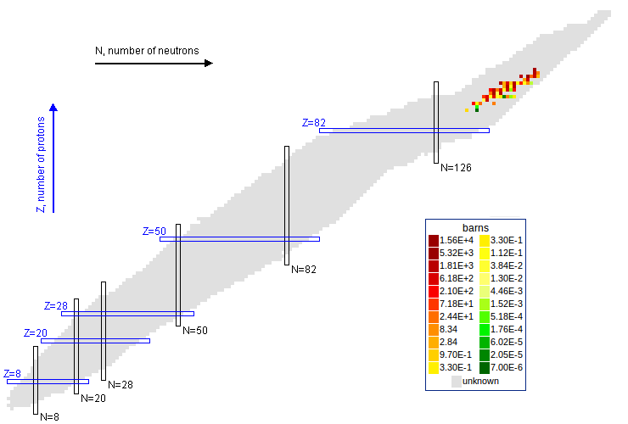
Fissile Material for Chain Reactions
A material capable of sustaining a nuclear fission chain reaction with neutrons of any energy
Fissile rule
90 ≤ Z ≤ 100
2Z - N = 43 ± 2
Different from a fissionable materials. All fissile materials are fissionable materials but not the other way around. Materials that require high energy neutrons are not considered fissile

Slide 39
Key Points
Write this in your notes
U-235 is a naturally-occurring isotope capable of starting and propagating a nuclear chain reaction.
A nuclear chain reaction is a self-sustaining sequence of nuclear fission reactions.
U-235 can do this because its fission creates more neutrons than it consumes.

Slide 40
Critical Mass
Critical mass is another key factor to consider
For a chain reaction to occur, there has to be enough fissionable atoms around to collide with released neutrons and propagate the chain.
Not enough - subcritical mass
Just enough - critical mass
More than enough - supercritical mass
Critical mass is the minimum amount of fissionable material necessary to sustain a nuclear chain reaction

Slide 42
Key Points
Write this in your notes
U-235 is a naturally-occurring isotope capable of starting and propagating a nuclear chain reaction.
A nuclear chain reaction is a self-sustaining sequence of nuclear fission reactions.
U-235 can do this because its fission creates more neutrons than it consumes.
Enough U-235 is needed to achieve critical mass, the minimum amount of fissionable material necessary to sustain a nuclear chain reaction

Slide 43
Outline
Nature of Fission & Fusion
Applications of Fission & Fusion
Balanced Nuclear Equations

Slide 44
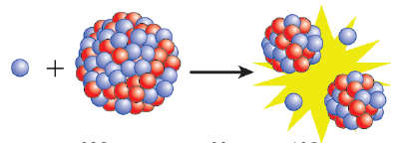
Fission of Uranium-235
When uranium-235 is bombarded with neutrons, it can break apart (undergo fissions) according to the equation:
$\begin{matrix}1 \\ 0\end{matrix}$n + $\begin{matrix}235 \\ 92\end{matrix}$U ª $\begin{matrix}99 \\ 42\end{matrix}$Mo + $\begin{matrix}135 \\ 50\end{matrix}$Sn + 2 $\begin{matrix}1 \\ 0\end{matrix}$n + energy

Slide 45
Balanced Nuclear Fission Equation
$\begin{matrix}1 \\ 0\end{matrix}$n + $\begin{matrix}235 \\ 92\end{matrix}$U ª $\begin{matrix}99 \\ 42\end{matrix}$Mo + $\begin{matrix}135 \\ 50\end{matrix}$Sn + 2 $\begin{matrix}1 \\ 0\end{matrix}$n

Slide 46
Balance the Mass Numbers
Mass Number
1 + 235 = 236
Mass Number
99 + 135 + (2 x 1) = 236
$\begin{matrix}1 \\ 0\end{matrix}$n + $\begin{matrix}235 \\ 92\end{matrix}$U ª $\begin{matrix}99 \\ 42\end{matrix}$Mo + $\begin{matrix}135 \\ 50\end{matrix}$Sn + 2 $\begin{matrix}1 \\ 0\end{matrix}$n

Slide 47
Balance the Atomic Numbers
Mass Number
1 + 235 = 236
Mass Number
99 + 135 + (2 x 1) = 236
$\begin{matrix}1 \\ 0\end{matrix}$n + $\begin{matrix}235 \\ 92\end{matrix}$U ª $\begin{matrix}99 \\ 42\end{matrix}$Mo + $\begin{matrix}135 \\ 50\end{matrix}$Sn + 2 $\begin{matrix}1 \\ 0\end{matrix}$n
Atomic Number
0 + 92 = 92
Atomic Number
42 + 50 + (2 x 0) = 92
As before, you can use balancing to determine a missing parent, daughter or radiation particle

Slide 48
Balanced Nuclear Fusion Equation
${}_{6}^{12}C$ + ${}_{1}^{1}H$ ${}_{6}^{13}C$ + ${}_{+1}^{0}e$

Slide 49
Balance the Mass Number
Mass Number
12 + 1 = 13
Mass Number
13 + 0 = 13
${}_{6}^{12}C$ + ${}_{1}^{1}H$ ${}_{6}^{13}C$ + ${}_{+1}^{0}e$

Slide 50
Balance the Atomic Number
Mass Number
12 + 1 = 13
Mass Number
13 + 0 = 13
${}_{6}^{12}C$ + ${}_{1}^{1}H$ ${}_{6}^{13}C$ + ${}_{+1}^{0}e$
Atomic Number
6 + 1 = 7
Atomic Number
6 + 1 = 7

Slide 51
Check for Understanding
Write this in your notes
The fission of plutonium-240 by a neutron can produce many fission products. In one case, it produces barium-138, rubidium-94, 9 neutrons and some radiation. Write the nuclear equation and determine the type of radiation is produced.

Slide 52
Summary
Characteristic | Radioactive Decay | Fission | Fusion
Starting Material(s) | 1 parent | 1 parent (trigger particle) | 2 parents (trigger conditions)
Product(s) | 1 daughter radiation | 2 daughters (more trigger particles) (radiation) | 1 daughter with larger A (other nuclei) (radiation)
Trigger | Spontaneous | Trigger (usually bombardment) | Trigger (usually extreme heat or pressure)
Objective | Improve n/p, o/e or Z>82 | Increase nuclear binding energy | Increase nuclear binding energy

Slide 53
Summary
Characteristic | Radioactive Decay | Fission | Fusion
Starting Material(s) | 1 parent | 1 parent (trigger particle) | 2 parents (trigger conditions)
Product(s) | 1 daughter radiation | 2 daughters (more trigger particles) (radiation) | 1 daughter with larger A (other nuclei) (radiation)
Trigger | Spontaneous | Trigger (usually bombardment) | Trigger (usually extreme heat or pressure)
Objective | Improve n/p, o/e or Z>82 | Increase nuclear binding energy | Increase nuclear binding energy

Slide 54
Check for Understanding
Write this in your notes
The fission of plutonium-240 by a neutron can produce many fission products. In one case, it produces barium-138, rubidium-94, 9 neutrons and some radiation. Write the nuclear equation and determine the type of radiation is produced.
ª
more
triggers
trigger
parent
2 daughters
radiation
$\begin{matrix}1 \\ 0\end{matrix}$n
+ $\begin{matrix}240 \\ 94\end{matrix}$Pu
ª
$\begin{matrix}138 \\ 56\end{matrix}$Ba
+ $\begin{matrix}94 \\ 37\end{matrix}$Rb
+ 9 $\begin{matrix}1 \\ 0\end{matrix}$n
+

Slide 55
Check for Understanding
Write this in your notes
The fission of plutonium-240 by a neutron can produce many fission products. In one case, it produces barium-138, rubidium-94, 9 neutrons and some radiation. Write the nuclear equation and determine the type of radiation is produced.
ª
more
triggers
trigger
parent
2 daughters
radiation
$\begin{matrix}1 \\ 0\end{matrix}$n
+ $\begin{matrix}240 \\ 94\end{matrix}$Pu
ª
$\begin{matrix}138 \\ 56\end{matrix}$Ba
+ $\begin{matrix}94 \\ 37\end{matrix}$Rb
+ 9 $\begin{matrix}1 \\ 0\end{matrix}$n
$\begin{matrix}0 \\ 1\end{matrix}$e
+

Slide 56
Check for Understanding
Two helium-3 atoms fuse together to form one helium-4 atom and some hydrogen-1. Write a balanced equations and determine how many atoms of hydrogen-1 are produced.
A = (2 x 3) = 6
A = 4
A = ?
2 $\begin{matrix}3 \\ 2\end{matrix}$He ª
$\begin{matrix}4 \\ 2\end{matrix}$He +
$\begin{matrix}1 \\ 1\end{matrix}$H
?
2
Z =(2 x 2) = 4
Z = 2 + (2 x 1) = 4

Slide 57
Check for Understanding
An unknown nuclide fuses with helium-4 to produce oxygen-16 and a neutron. Write a balanced nuclear equation that describes this fusion reaction.
$\begin{matrix}13 \\ 6\end{matrix}$C + $\begin{matrix}4 \\ 2\end{matrix}$He ª $\begin{matrix}16 \\ 8\end{matrix}$O + $\begin{matrix}1 \\ 0\end{matrix}$n

Slide 58
Check for Understanding
The fission of uranium-235 by a neutron can produce many fission products. For the case where it produces krypton-91 (Kr) and barium-142 (Ba), write the nuclear equation and determine how many neutrons are produced.
$\begin{matrix}1 \\ 0\end{matrix}$n + $\begin{matrix}235 \\ 92\end{matrix}$U ª $\begin{matrix}91 \\ 36\end{matrix}$Kr + $\begin{matrix}142 \\ 56\end{matrix}$Ba + 3 $\begin{matrix}1 \\ 0\end{matrix}$n

Slide 59
Check for Understanding
Lawrencium-257 and six neutrons were produced through the fusion of californium-252 and another nuclide. Write a balanced nuclear equation that describes this fusion reaction.
$\begin{matrix}252 \\ 98\end{matrix}$Cf + $\begin{matrix}11 \\ 5\end{matrix}$B ª $\begin{matrix}257 \\ 103\end{matrix}$Lr + 6 $\begin{matrix}1 \\ 0\end{matrix}$n

Slide 60
Check for Understanding
The fission of uranium-235 by a neutron can produce many fission products. For the case where it produces yttrium-97 (Y), five neutrons and another fission product, write the nuclear equation and determine what other fission product is made.

Slide 61
Check for Understanding
The fission of uranium-235 by a neutron can produce many fission products. For the case where it produces yttrium-97 (Y), five neutrons and another fission product, write the nuclear equation and determine what other fission product is made.
$\begin{matrix}1 \\ 0\end{matrix}$n + $\begin{matrix}235 \\ 92\end{matrix}$U ª $\begin{matrix}97 \\ 39\end{matrix}Y$ + $\begin{matrix}134 \\ 53\end{matrix}$I + 5 $\begin{matrix}1 \\ 0\end{matrix}$n

Slide 62
Check for Understanding
Bombardment of an unknown parent atom by a neutron results in a fission reaction. The products are lanthanum-137 (La), rubidium-94 (Rb), and 10 neutrons. Write the nuclear equation and determine the unknown parent atom.

Slide 63
Check for Understanding
Bombardment of an unknown parent atom by a neutron results in a fission reaction. The products are lanthanum-137 (La), rubidium-94 (Rb), and 10 neutrons. Write the nuclear equation and determine the unknown parent atom.
$\begin{matrix}1 \\ 0\end{matrix}$n + $\begin{matrix}240 \\ 94\end{matrix}$Pu ª $\begin{matrix}137 \\ 57\end{matrix}$La + $\begin{matrix}94 \\ 37\end{matrix}$Rb + 10 $\begin{matrix}1 \\ 0\end{matrix}$n

Slide 64
Check for Understanding
The fusion of uranium-238 and nitrogen-14 produces a fusion product and four neutrons. Write a balanced nuclear equation that describes this fusion reaction.
$\begin{matrix}238 \\ 92\end{matrix}$U + $\begin{matrix}14 \\ 7\end{matrix}$N ª $\begin{matrix}248 \\ 99\end{matrix}$Es + 4 $\begin{matrix}1 \\ 0\end{matrix}$n

Slide 65
Outline
Nature of Fission & Fusion
Applications of Fission & Fusion
Balanced Nuclear Equations

Slide 66
Summary
Write this in your notes
Characteristic | Radioactive Decay | Fission | Fusion
Starting Material(s) | 1 parent | 1 parent (trigger particle) | 2 parents (trigger conditions)
Product(s) | 1 daughter radiation | 2 daughters (more trigger particles) (radiation) | 1 daughter with larger A (other nuclei) (radiation)
Trigger | Spontaneous | Trigger (usually bombardment) | Trigger (usually extreme heat or pressure)
Objective | Improve n/p, o/e or Z>82 | Increase nuclear binding energy | Increase nuclear binding energy

Slide 67
Backup Slides

Slide 68
Videos
How atomic weapons work
https://www.youtube.com/watch?v=fYuVzbIu_8o
s

Slide 69
Summary
Write this in your notes
Characteristic | Radioactive Decay | Fission | Fusion
Starting Material(s) | 1 parent | 1 parent (trigger particle) | 2 parents (trigger conditions)
Product(s) | 1 daughter radiation | 2 daughters (more trigger particles) (radiation) | 1 daughter with larger A (other nuclei) (radiation)
Trigger | Spontaneous | Trigger (usually bombardment) | Trigger (usually extreme heat or pressure)
Objective | Improve n/p, o/e or Z>82 | Increase nuclear binding energy | Increase nuclear binding energy

