Slide 1
Do Now: Math Skills for Half-Life Lesson
Put your name on a piece of paper and number it from 1 to 5. Next to each number, write the value for x. If you don't know, leave it blank. Put your sheet in the red basket when done.
1) x = ($\frac{1}{2}$)³
x = $\frac{1}{8}$
4) ($\frac{1}{2}$)^{x} = $\frac{1}{8}$
x = 3
$$1/3$$
2) x = 27
x = 3
5) ($\frac{1}{2}$)^{6x} = 0.0625
x = 0.667
$$3/4$$
3) x = 16
x = 8

Slide 2
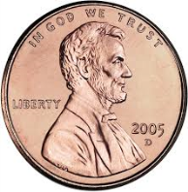
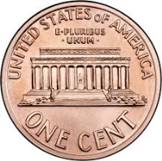
Do Now
Laura and Paul are doing an experiment to investigate the concept of half-life using the following procedure:
Toss 24 pennies
Count how many are heads
Remove the tails and toss the again
Repeat until all are gone
Fill out the table shown
Predict the results for the table
and explain your reasoning
Toss Number | Number of Heads
1
2
3

Slide 3
First Toss

Slide 4
First Toss

Slide 5
Second Toss

Slide 6
Second Toss

Slide 7
Third Toss

Slide 8
Third Toss

Slide 9
Do Now
Laura and Paul are doing an experiment to investigate the concept of half-life using the following procedure:
Toss 24 pennies
Count how many are heads
Remove the tails and toss the again
Repeat until all are gone
Fill out the table shown
Predict the results for the table and explain your reasoning
Toss Number | Number of Heads
1 | 12
2 | 6
3 | 3

Slide 10
Kinetics of Nuclear Decay
Write this in your notes
SWBAT explain the kinetics of radioactive decay and complete half-life calculations.

Slide 11
Half-Life
Nuclear Half-Life - The time required for one half of the radioactive nuclei to decay.
Write this in your notes

Slide 12
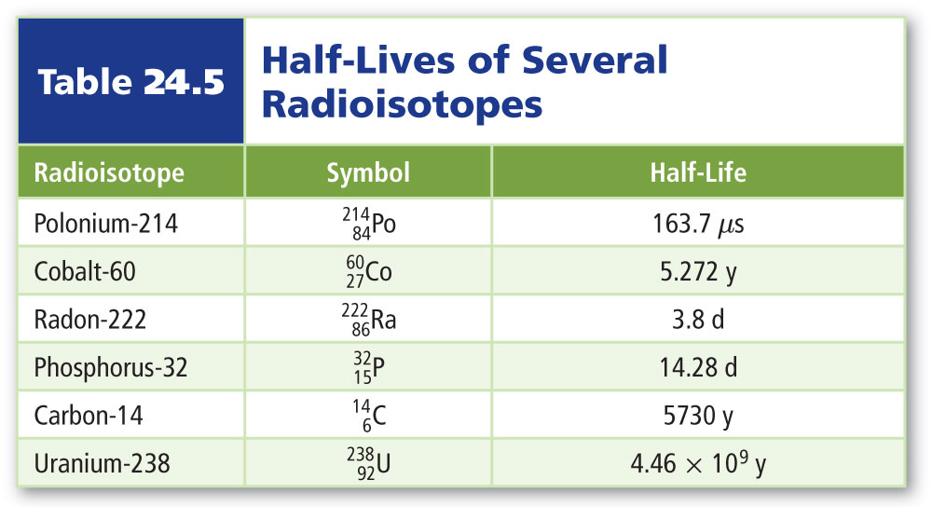
Examples of Half-Lives
SECTION24.2
Radioactive Decay

Slide 13
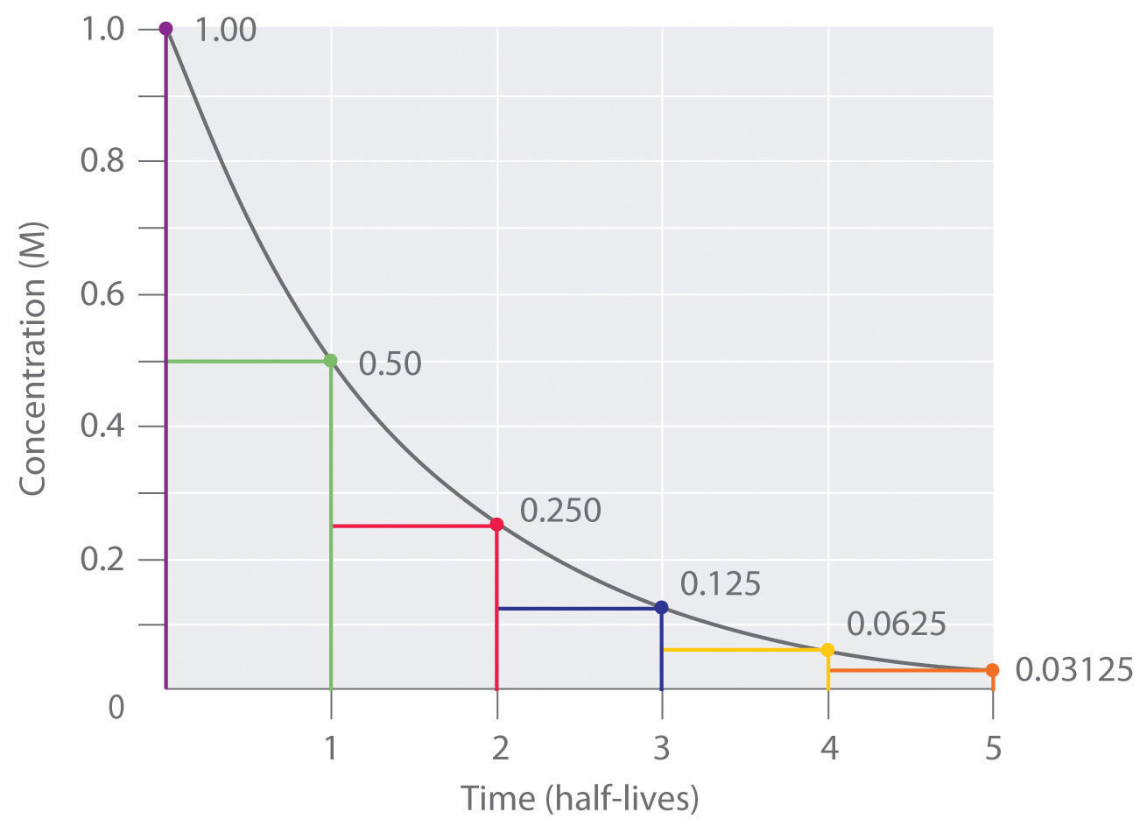
Graphical Representation

Slide 14
Example
Number of Half-Lives | Nuclei Remaining
0 | 24
1
2
3

Slide 15
Example
Number of Half-Lives | Nuclei Remaining
0 | 24
1 | 12
2 | 6
3 | 3

Slide 16
Example
Number of Half-Lives | Nuclei Remaining | Math
0 | 24
1 | 12 | 24 x $\frac{1}{2}$ = 12
2 | 6 | 24 x $\frac{1}{2}$ x $\frac{1}{2}$ = 6
3 | 3 | 24 x $\frac{1}{2}$ x $\frac{1}{2}$ x $\frac{1}{2}$ = 3

Slide 17
Example
Number of Half-Lives | Nuclei Remaining | Math | Advanced Math
0 | 24
1 | 12 | 24 x $\frac{1}{2}$ = 12 | 24 x ($\frac{1}{2}$)¹ = 12
2 | 6 | 24 x $\frac{1}{2}$ x $\frac{1}{2}$ = 6 | 24 x ($\frac{1}{2}$)² = 6
3 | 3 | 24 x $\frac{1}{2}$ x $\frac{1}{2}$ x $\frac{1}{2}$ = 3 | 24 x ($\frac{1}{2}$)³ = 3

Slide 18
Example
Number of Half-Lives | Nuclei Remaining | Math | Advanced Math
0 | 24 |  | 24 x ($\frac{1}{2}$)⁰ = 24
1 | 12 | 24 x $\frac{1}{2}$ = 12 | 24 x ($\frac{1}{2}$)¹ = 12
2 | 6 | 24 x $\frac{1}{2}$ x $\frac{1}{2}$ = 6 | 24 x ($\frac{1}{2}$)² = 6
3 | 3 | 24 x $\frac{1}{2}$ x $\frac{1}{2}$ x $\frac{1}{2}$ = 3 | 24 x ($\frac{1}{2}$)³ = 3

Slide 19
Example
Number of Half-Lives | Nuclei Remaining | Math | Advanced Math
0 | 24 |  | 24 x ($\frac{1}{2}$)⁰ = 24
1 | 12 | 24 x $\frac{1}{2}$ = 12 | 24 x ($\frac{1}{2}$)¹ = 12
2 | 6 | 24 x $\frac{1}{2}$ x $\frac{1}{2}$ = 6 | 24 x ($\frac{1}{2}$)² = 6
3 | 3 | 24 x $\frac{1}{2}$ x $\frac{1}{2}$ x $\frac{1}{2}$ = 3 | 24 x ($\frac{1}{2}$)³ = 3

Slide 20
Equation
Write this in your notes
where
N = remaining amount
N₀ = initial amount
n = number of half-lives
t = time elapsed
T = half-life
$$t/T$$
N = N₀($\frac{1}{2}$)
n = $t/T$

Slide 21
Half-Life Problems 1 (Easy)
An isotope has a half-life of 5.0 years. How much of 1.2 kg sample remains after 15 years?
3 half-lives, so 1.2 è 0.6 è 0.3 è 0.15 kg
An isotope has a half-life of 15 minutes. How much of a 400 gram sample will remain after 1 hour?
4 half-lives, so 400 è 200 è 100 è 50 è 25 g
An isotope has a half-life of 4 hours. If 0.75 grams remains after 8 hours, what was the initial amount?
2 half-lives, so 0.75 è 1.5 è 3.0 g

Slide 22
Half-Life Problems 1 (Easy)
An isotope has a half-life of 5.0 years. How much of 1.2 kg sample remains after 15 years?
3 half-lives, so 1.2 è 0.6 è 0.3 è 0.15 kg
An isotope has a half-life of 15 minutes. How much of a 400 gram sample will remain after 1 hour?
4 half-lives, so 400 è 200 è 100 è 50 è 25 g
An isotope has a half-life of 4 hours. If 0.75 grams remains after 8 hours, what was the initial amount?
2 half-lives, so 0.75 è 1.5 è 3.0 g

Slide 23
Half-Life Problems 1 (Easy)
An isotope has a half-life of 5.0 years. How much of 1.2 kg sample remains after 15 years?
3 half-lives, so 1.2 è 0.6 è 0.3 è 0.15 kg
An isotope has a half-life of 15 minutes. How much of a 400 gram sample will remain after 1 hour?
4 half-lives, so 400 è 200 è 100 è 50 è 25 g (---> 30 g)
An isotope has a half-life of 4 hours. If 0.75 grams remains after 8 hours, what was the initial amount?
2 half-lives, so 0.75 è 1.5 è 3.0 g

Slide 24
Half-Life Problems 1 (Easy)
An isotope has a half-life of 5.0 years. How much of 1.2 kg sample remains after 15 years?
3 half-lives, so 1.2 è 0.6 è 0.3 è 0.15 kg
An isotope has a half-life of 15 minutes. How much of a 400 gram sample will remain after 1 hour?
4 half-lives, so 400 è 200 è 100 è 50 è 25 g (---> 30 g)
An isotope has a half-life of 4 hours. If 0.75 grams remains after 8 hours, what was the initial amount?
2 half-lives, so 0.75 è 1.5 è 3.0 g

Slide 25
Half-Life Problems 2 (Easy)
Strontium-90 has a half-life of 29 years. If a 640 gram sample is allowed to stand for 87 years, how much strontium-90 will remain?
3 half-lives, so 640 è 320 è 160 è 80 g
Fermium-253 has a half-life of 3.0 days. After sitting for 12 days, a sample of fermium-253 weighs 0.22 grams. What was the initial mass?
4 half-lives, so 0.22 è 0.44 è 0.88 è 1.76 è 3.52 g
320 mg of new radioactive isotope is created. After 4.0 days, only 40 mg remain. What is the half-life in hours of the new isotope?
4 days = 96 hours. 3 half-lives have passed, so t_{1/2} = 32 h

Slide 26
Half-Life Problems 2 (Easy)
Strontium-90 has a half-life of 29 years. If a 640 gram sample is allowed to stand for 87 years, how much strontium-90 will remain?
3 half-lives, so 640 è 320 è 160 è 80 g
Fermium-253 has a half-life of 3.0 days. After sitting for 12 days, a sample of fermium-253 weighs 0.22 grams. What was the initial mass?
4 half-lives, so 0.22 è 0.44 è 0.88 è 1.76 è 3.52 g
320 mg of new radioactive isotope is created. After 4.0 days, only 40 mg remain. What is the half-life in hours of the new isotope?
4 days = 96 hours. 3 half-lives have passed, so t_{1/2} = 32 h

Slide 27
Half-Life Problems 2 (Easy)
Strontium-90 has a half-life of 29 years. If a 640 gram sample is allowed to stand for 87 years, how much strontium-90 will remain?
3 half-lives, so 640 è 320 è 160 è 80 g
Fermium-253 has a half-life of 3.0 days. After sitting for 12 days, a sample of fermium-253 weighs 0.22 grams. What was the initial mass?
4 half-lives, so 0.22 è 0.44 è 0.88 è 1.76 è 3.52 g
320 mg of new radioactive isotope is created. After 4.0 days, only 40 mg remain. What is the half-life in hours of the new isotope?
4 days = 96 hours. 3 half-lives have passed, so t_{1/2} = 32 h

Slide 28
Half-Life Problems 2 (Easy)
Strontium-90 has a half-life of 29 years. If a 640 gram sample is allowed to stand for 87 years, how much strontium-90 will remain?
3 half-lives, so 640 è 320 è 160 è 80 g
Fermium-253 has a half-life of 3.0 days. After sitting for 12 days, a sample of fermium-253 weighs 0.22 grams. What was the initial mass?
4 half-lives, so 0.22 è 0.44 è 0.88 è 1.76 è 3.52 g
320 mg of new radioactive isotope is created. After 4.0 days, only 40 mg remain. What is the half-life in hours of the new isotope?

Slide 29
Do Now
Strontium-91 undergoes beta decay with a half-life of 9.0 years.
Write a balanced nuclear equation
If a 6.4 g sample is allowed to stand for 36 years, how much strontium-91 will remain?
$\begin{matrix}91 \\ 38\end{matrix}$Sr ª $\begin{matrix}91 \\ 39\end{matrix}$Y + $\begin{matrix} 0 \\ −1\end{matrix}$e
4 half-lives, so 6.4 è 3.2 è 1.6 è 0.8 è 0.4 g

Slide 30
Half-Life Equation
Review
N = N₀$(\frac{1}{2})^{t/T}$
where
N = remaining amount
N₀ = initial amount
t = time elapsed
T = half-life

Slide 31
Half-Life Problems 2 (Easy)
320 mg of new radioactive isotope is created. After 4.0 days, only 40 mg remain. What is the half-life in hours of the new isotope?
How many half-lives need to occur to change 320 mg to 40 mg?
320 è 160 è 80 è 40
3 half-lives
If 3 half-lives takes 4 days, how long does one half-life take?
n = $t/T$
T = $t/n$
= ${4 days}/{3 half−lives}$
= ${96 hours}/{3 half−lives}$
= 32 hours per half -life

Slide 32
Half-Life Problems 2 (Easy)
320 mg of new radioactive isotope is created. After 4.0 days, only 40 mg remain. What is the half-life in hours of the new isotope?

Slide 33
Half-Life Problems 3 (Medium)
A 540 gram sample of polonium-210 is stored in a freezer at Lawrence Livermore Laboratories. If this isotope has a half-life of 138 days, how much remains after exactly two years?
N = N₀$(\frac{1}{2})^{t/T}$
N = ($540 g)(\frac{1}{2})^{{730 days}/{138 days}}$
N = ($540 g)(\frac{1}{2})^{5.29}$
N = 13.8 g ---> 14 g

Slide 34
Half-Life Problems 4 (Medium)
Carbon-10 is highly unstable with a half-life of 19.3 seconds. A researcher produces a sample of carbon-10 using new equipment, but it takes 83 seconds to measure the mass. By that time, the mass is 4.7 mg. What was the original mass?
N = N₀$(\frac{1}{2})^{t/T}$
N₀ = $\frac{N}{(\frac{1}{2})^{t/T}}$
N₀ = $\frac{4.7 mg}{(\frac{1}{2})^{{83 s}/{19.3 s}}}$
N₀ = 92.6 mg ---> 93 mg

Slide 35
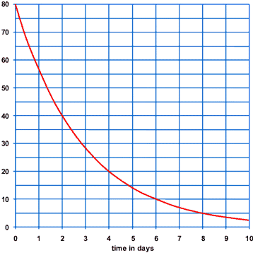
Half-Life Problems 6 (Medium)
This graph shows the decay of a radioactive isotope. What is its half-life?
2 days

Slide 36
Half-Life Problems 7 (Medium)
A 72 gram sample of plutonium-244 has decayed to 9.0 grams in 18 minutes. What is its half-life?
N = N₀$(\frac{1}{2})^{t/T}$
9.0 = 72$(\frac{1}{2})^{t/T}$
$\frac{9.0}{72}$= $\frac{1}{8}$ = $(\frac{1}{2})^{t/T}$
To what number do you raise $1/2$ to get $1/8$?
3
$$t/T=3$$
$${18}/T=3$$
T = ${18}/3=6$

Slide 37
Half-Life Problems 8 (Hard)
Researchers recently produced the first samples of carbon-20. They used instrumentation which can measure mass down to 2.6 ng (2.6 x 10⁻⁹g). The initial sample of 86.3 ng fell below their limits of detection in 81 milliseconds. What is the half-life of carbon-20?
N = N₀$(\frac{1}{2})^{t/T}$
2.6 ng = 86.3 ng$(\frac{1}{2})^{{81 ms}/T}$
$\frac{2.6 ng}{86.3 ng}$ = $(\frac{1}{2})^{{81 ms}/T}$
0.030 =
log_{0.5}(0.030) = $\frac{log(0.030)}{log(0.5)}$
$\frac{81 ms}{T}$ = log_{0.5}(0.030)
= 5.06
$\frac{81 ms}{5.06}$ = T
= 16 milliseconds

Slide 38
Optional Homework

Slide 39
Do Now
Strontium-91 has a half-life of 9.0 years. If a 6.4 g sample is allowed to stand for 36 years, how much strontium-91 will remain?
Scandium-46 undergoes beta decay with a half-life of 83.8 days. Write a balanced nuclear equation for this decay and determine how long it would take for a 26.4 g sample to decay to 3.30 g.
4 half-lives, so 6.4 è 3.2 è 1.6 è 0.8 è 0.4 g
$\begin{matrix}46 \\ 21\end{matrix}$Sc ª $\begin{matrix}46 \\ 22\end{matrix}$Ti + $\begin{matrix} 0 \\ −1\end{matrix}$e
26.4 è 13.2 è 6.6 è 3.3, so 3 half-lives,
so 3 x 83.8 = 251 days

Slide 40
Do Now
Strontium-91 has a half-life of 9.0 years. If a 6.4 g sample is allowed to stand for 36 years, how much strontium-91 will remain?
Scandium-46 undergoes beta decay with a half-life of 83.8 days. Write a balanced nuclear equation for this decay and determine how long it would take for a 26.4 g sample to decay to 3.30 g.
4 half-lives, so 6.4 è 3.2 è 1.6 è 0.8 è 0.4 g
$\begin{matrix}46 \\ 21\end{matrix}$Sc ª $\begin{matrix}46 \\ 22\end{matrix}$Ti + $\begin{matrix} 0 \\ −1\end{matrix}$e
26.4 è 13.2 è 6.6 è 3.3, so 3 half-lives,
so 3 x 83.8 = 251 days

Slide 41
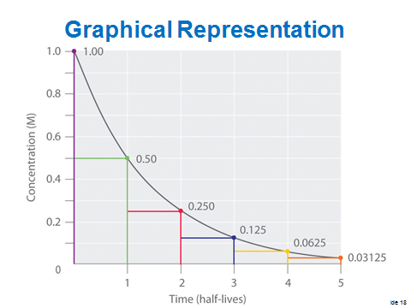
Last Class

Slide 42
Half-Life Equation
Review
N = N₀$(\frac{1}{2})^{t/T}$
where
N = remaining amount
N₀ = initial amount
t = time elapsed
T = half-life

Slide 43
Second Lesson Finish

Slide 44
Outline 1
Radioactive Decay Rates
Half-life
Hand calculation and equation
hand calculations
forward in time to final amount
backward in time to initial amount
how long until a certain amount is left
time changes that are not whole number multiples of half life
calculate half-life from time, No and N
graphing to get info
REMEMBER order of operations
Radiochemical Dating
worksheet

Slide 45
Types of Half-Life Problems
difficulty | description
easy | Givens are t, T & either N or No. t/T is a whole number. Count forward or backward the number of half-lives to get unknown.
easy | Givens are N, No & either t or T. t/T is a whole number. Start at No, cut in half repeatedly until reaching N, determine number of half-lives, solve for unknown
medium | Givens are t, T and either N or No. t/T is not a whole number. Use formula to find either N or No
medium | Read half-life off of a graph
medium | Givens are N, No and either t or T. t/T is a whole number. Calculate N/No, determine power of ½ is represented by fraction, use power to solve for unknown.
hard | Givens are N, No and either t or T. t/T is not a whole number. Calculate N/No, determine power of ½ is represented by fraction, use power to solve for unknown.

Slide 46
Sig Figs for Exponents
How many sig figs for this problem?
An isotope has a half-life of 5 years. How much of 1.2 kg sample remains after 15 years?
$$N=(1.2)(\frac{1}{2})^{{15}/5}=0.15 kg$$
All the values given are measured
15 years could actually be 14.5 to just under 15.5
5 years could actually be 4.5 to just under 5.5
Range of answers
$$(\frac{1}{2})^{{15.5}/{4.5}}=0.160833 (0.035833 higher)$$
$$(\frac{1}{2})^{{15}/5}=0.125$$
$$(\frac{1}{2})^{{14.5}/{5.5}}=0.091858 (0.033142 lower)$$
Conclusion: 0.125 ± 0.036 or 0.1 (1 sig fig)

Slide 47
It takes time for half of the parents to decay
That amount of time is the half-life

Slide 48
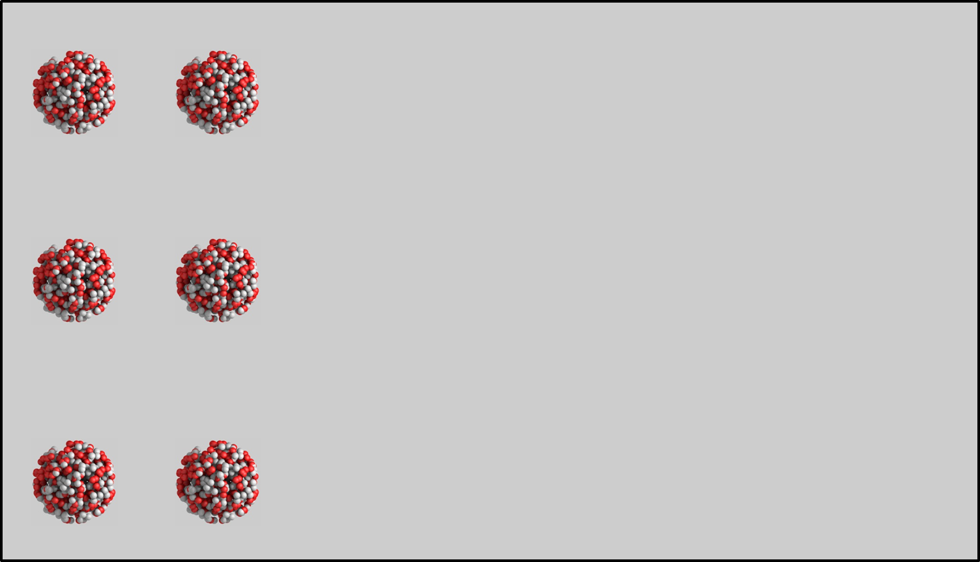
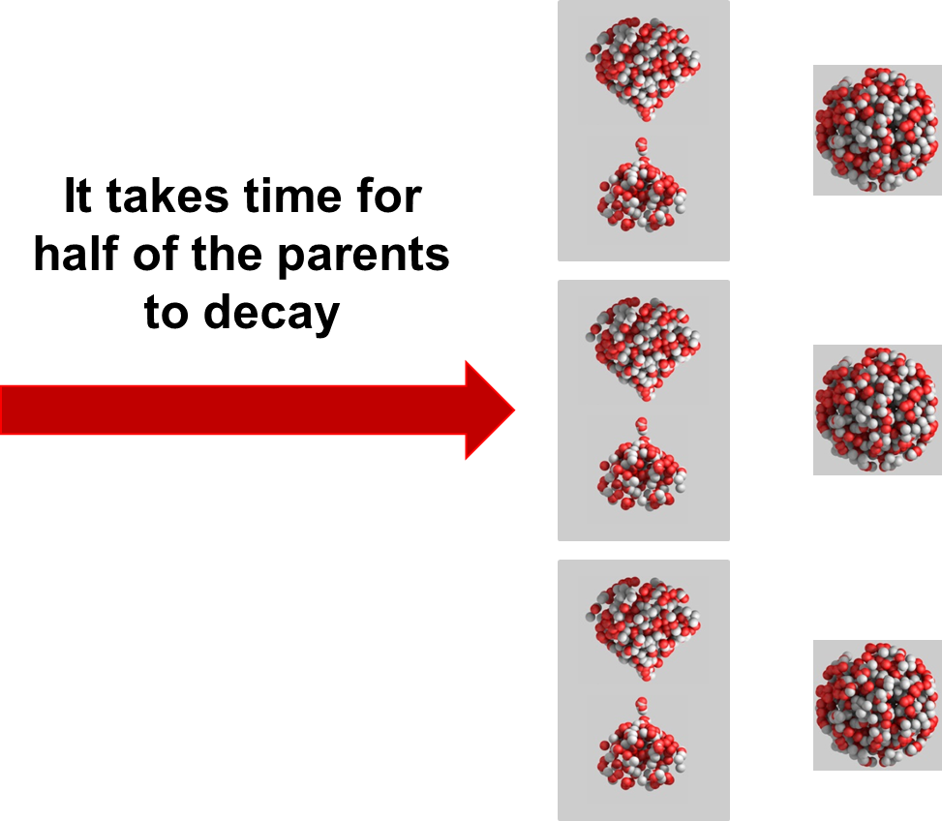

Slide 51
Do Now
Strontium-91 undergoes beta decay with a half-life of 9.0 years.
Write a balanced nuclear equation
If a 6.4 g sample is allowed to stand for 36 years, how much strontium-91 will remain?
$\begin{matrix}91 \\ 38\end{matrix}$Sr ª $\begin{matrix}91 \\ 39\end{matrix}$Y + $\begin{matrix} 0 \\ −1\end{matrix}$e
4 half-lives, so 6.4 è 3.2 è 1.6 è 0.8 è 0.4 g

Slide 52
Last Class

Slide 53
Half-Life Equation
Review
N = N₀$(\frac{1}{2})^{t/T}$
where
N = remaining amount
N₀ = initial amount
t = time elapsed
T = half-life

Slide 54
Life in the Nucleus of an Atom
Strong nuclear force and electromagnetic force are always fighting each other

Slide 55
Life in the Nucleus of an Atom
Strong nuclear force and electromagnetic force are always fighting each other
The nucleus is constantly experiencing motion and deformation

Slide 56
Life in the Nucleus of an Atom
Strong nuclear force and electromagnetic force are always fighting each other
The nucleus is constantly experiencing motion and deformation
Sometimes this gets out of control

Slide 57
Life in the Nucleus of an Atom
Strong nuclear force and electromagnetic force are always fighting each other
The nucleus is constantly experiencing motion and deformation
Sometimes this gets out of control
The nucleus deforms in such a way that it cannot recover

Slide 58
Life in the Nucleus of an Atom
The random deformation of the nucleus presents opportunities for decay.
With each passing second, there is a certain probability that decay will occur.
This probability is independent of
previous events
other nuclei

Slide 59
Life in the Nucleus of an Atom

Slide 60
Life in the Nucleus of an Atom

Slide 61
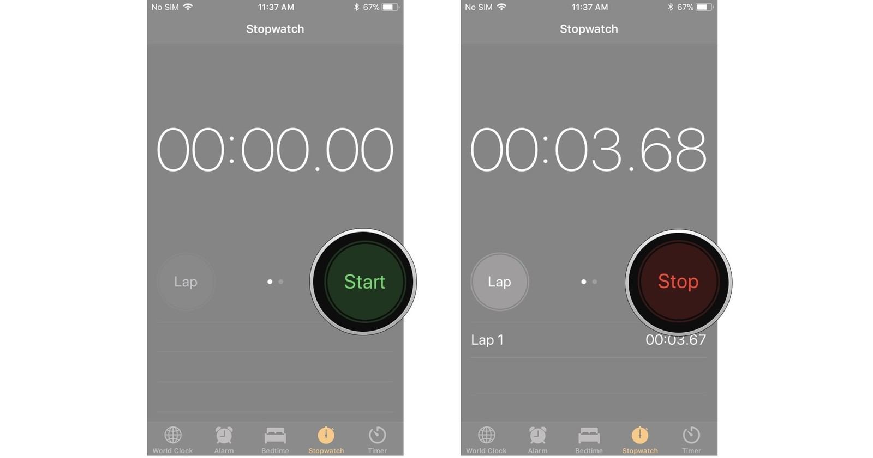
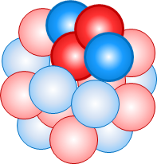
Half-Life
Nuclear Half-Life - The time required for one half of the radioactive nuclei to decay.
Write this in your notes

Slide 62
Half-Life
Nuclear Half-Life - The time required for one half of the radioactive nuclei to decay.
Write this in your notes

Slide 63
Half-Life
Nuclear Half-Life - The time required for one half of the radioactive nuclei to decay.
Write this in your notes

Slide 64
Do Now
Strontium-91 has a half-life of 9.0 years. If a 6.4 g sample is allowed to stand for 36 years, how much strontium-91 will remain?
Scandium-46 undergoes beta decay with a half-life of 83.8 days. Write a balanced nuclear equation for this decay and determine how long it would take for a 26.4 g sample to decay to 3.30 g.
4 half-lives, so 6.4 è 3.2 è 1.6 è 0.8 è 0.4 g
$\begin{matrix}46 \\ 21\end{matrix}$Sc ª $\begin{matrix}46 \\ 22\end{matrix}$Ti + $\begin{matrix} 0 \\ −1\end{matrix}$e
26.4 è 13.2 è 6.6 è 3.3, so 3 half-lives,
so 3 x 83.8 = 251 days

Slide 65
Equation
(remaining amount) = (initial amount)($\frac{1}{2}$)^{number of half-lives}
N = N₀($\frac{1}{2}$)^{n}

Slide 66
Equation
Write this in your notes
If the time elapsed is not a whole-number multiple of the half-life, then the number of half-lives must be calculated
n = $t/T$
where
t = time elapsed
T = half-life
N = remaining amount
N₀ = initial amount
n = number of half-lives
N = N₀($\frac{1}{2}$)^{n} = N₀($\frac{1}{2}$)
$$t/T$$

Slide 67
Equation
(remaining amount) = (initial amount)($\frac{1}{2}$)^{number of half-lives}
N = N₀($\frac{1}{2}$)^{n}
where
N = remaining amount
N₀ = initial amount
n = number of half-lives

