Slide 1
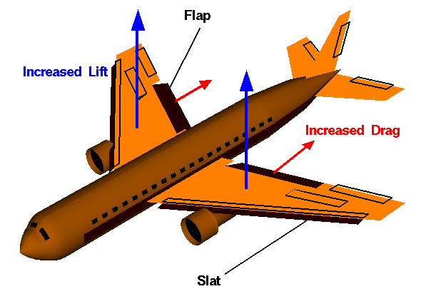
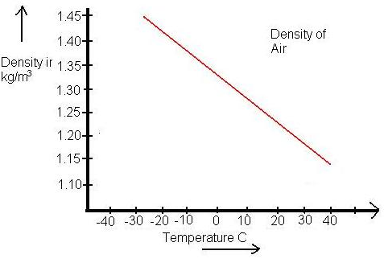
Do Now
Aircraft can fly because air molecules flowing around their wings generate lift. Lift increases if the wings encounter more air molecules. Thus, the density of air is a key factor in lift.
When aircraft take off and land, they extend flaps on their wings to make the wings bigger, increase lift, and allow them to be airborne at lower speeds. These flaps can be extended different amounts depending on the lift needed.
Which plane will need to extend their flaps more, a plane taking off from Boston in the winter or same plane taking off from Miami in the summer? Write a prediction and justify your answer.

Slide 2
If a plane is taking off from Miami in the summer, then it will need to extend its flaps more than the same plane taking off from Boston in the winter.
This is because lift increases with air density and air density drops with increasing temperature.
Miami in the summer will have a higher temperature than Boston in the winter, thus the plane will need to extend its flaps more in Miami.

Slide 3
Writing Hypotheses
Write this in your notes
SWBAT write a complete hypothesis using the "If . . . , then . . . , because . . ." method.

Slide 4
Today's Lesson
We will review & grade our responses to the worksheet on "Nuclear Decay of Isotopes - Part 1".
Partner with 1-2 other people and grade each other's papers.
These do not count toward your grade, so focus on learning how you can better write hypotheses.
"Nuclear Decay of Isotopes - Part 2" will be next and its grade will count.

Slide 5
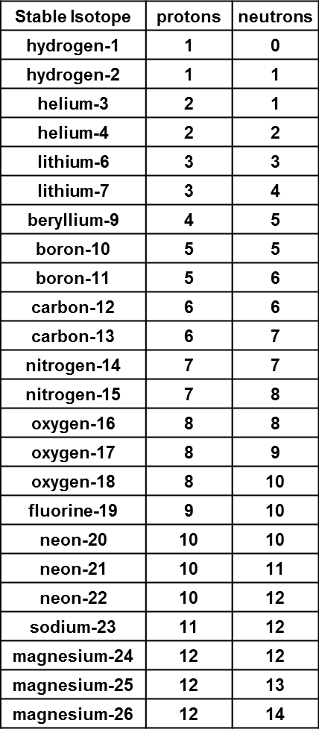
Question 1
Plot the stable isotopes found from hydrogen to magnesium. Put the protons on the x-axis, the neutrons on the y-axis, and mark a point for each stable isotope. After the graph is made, draw a best fit line. Try to have it go through the middle of the points and have as many points above the line as below.
❶

Slide 6
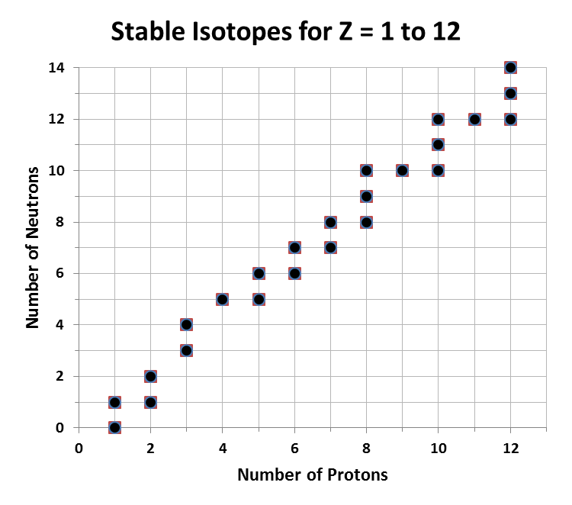

Slide 7
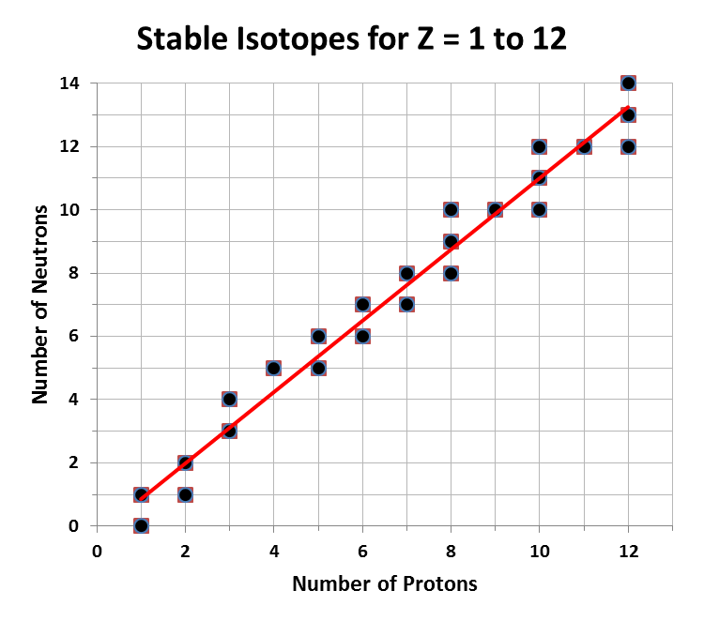
Grading
2 pts All points plotted, properly labeled, & best fit line goes through the middle.
1 pt Improper labeling or improper best fit line
0 pt Improper plotting of points

Slide 8
Question 2
Choose two points that are on the line and determine the slope. Be sure to include the proper units for the slope.
❷

Slide 9
(9, 10)
$$slope= \frac{y2−y1}{x2−x1}$$
(2, 2)
$$=\frac{10 −2}{9 −2}$$
$$=\frac{8}{7}=1.1$$

Slide 10
$$slope= \frac{y2−y1}{x2−x1}$$
$$=\frac{4 −0}{3 −1}$$
(1, 0)
$$=\frac{4}{2}=2.0$$
(3, 4)

Slide 11
What are the units for the slope?
$$slope= \frac{∆y}{∆x}$$
What units are on the y-axis?
neutrons
What units are on the x-axis?
protons
Therefore, the units for the slope are:
$$units= \frac{neutrons}{protons}= \frac{n}{p}$$

Slide 12
Question 2
Choose two points that are on the line and determine the slope. Be sure to include the proper units for the slope.
❷
Grading
2 pts Proper slope (1.0 - 1.2) and proper units (n/p)
1 pt Improper slope or improper units
0 pt Both improper

Slide 13
Question 3
Consider the research question. What hypothesis would you draw based upon the graph you made?
❸
How do the number of protons & neutrons affect the stability of a nucleus?

Slide 14
General Advice
Write this in your notes
Identify the causative relationship
Write your answer and the reason behind it
If . . . , then . . . , because . . .
Use their words and give details
"What hypothesis would you draw based upon the graph you made?"
"Based upon the graph, I hypothesize that if a nuclei has a ratio of neutrons to protons of ~1.1, then that nuclei will be stable. I hypothesize this because the best fit line of my graph of stable isotopes has a slope of 1.1 n/p.

Slide 16
General Advice
Write this in your notes
Identify the causative relationship
Write your answer and the reason behind it
If . . . , then . . . , because . . .
Use their words and give details
"What hypothesis would you draw based upon the graph you made?"

Slide 17
If a plane is taking off from Miami in the summer, then it will need to extend its flaps more than the same plane taking off from Boston in the winter,
This is because lift increases with air density and air density drops with increasing temperature.
Miami in the summer will have a higher temperature than Boston in the winter, thus the plane will need to extend its flaps more in Miami.

Slide 18
1st Example from Question 3
"Isotopes that have the same or similar (1-3 difference) numbers of protons and neutrons in the nucleus are stable. More neutrons than protons is stable, but more protons than neutrons is unstable"
Clearly identifies the causative relationship.
Provides the "if" and "then", but not "because"
Gives details but does not use words from the question.
Justin Bessette

Slide 19
2nd Example from Question 3
"My hypothesis is that an element will be stable if the number of protons and neutrons in the atom are equal or if the nucleus contains one more neutron than proton."
Clearly identifies the causative relationship.
Provides the "if" and "then", but not "because"
Gives details and uses words from the question.
Emma Bartlett

Slide 20
3rd Example from Question 3
"Considering the research question, I would hypothesize that stable elements all have protons and neutrons close together. Either the Np and Nn are equal or they are 1 or 2 apart. I think elements that have a greater number difference are unstable."
Clearly identifies the causative relationship.
Provides the "if" and "then", but not "because"
Gives details and uses words from the question.
Madison Freeborn

Slide 21
4th Example from Question 3
"All of the stable isotopes have positive charges, or neutral charges in the nucleus."
Misses the causative relationship.
Response is not related to the graph at all.
Provides the "if" and "then", but not "because"
Few details and no words from the question.
Bailey Burke

Slide 22
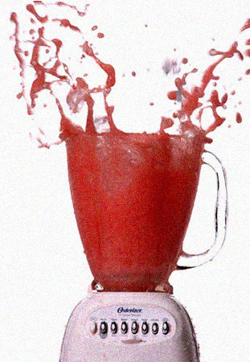
5th Example from Question 3
"Based upon the graph, I would hypothesize that the difference in nuclear stability of different isotopes related to the number of protons and neutrons is that amount of protons and neutrons affect the nuclear force of the atom."
Sean Donahue

Slide 23
Question 3
Consider the research question. What hypothesis would you draw based upon the graph you made?
"Based upon the graph, I hypothesize that if a nuclei has a ratio of neutrons to protons of ~1.1, then that nuclei will be stable. I hypothesize this because the best fit line of my graph of stable isotopes has a slope of 1.1 n/p.
❸

Slide 24
Question 3
Consider the research question. What hypothesis would you draw based upon the graph you made?
❸
Grading
3 pts Correctly identifies the causative relationship (n/p ≈ 1.1 means stable), gives reason (slope), sufficient details, and statement is clear
2 pts Correctly identifies the causative relationship, gives reason, but minimal details and/or clarity.
1 pts Correctly identifies the causative relationship, but does not give reason.
0 pt Does not identify the causative relationship.

Slide 25
Question 4
❹
Consider what happens to EMF and SNF interactions when a proton or a neutron is added to the nucleus. Write a brief explanation as to why neutrons are sometimes called the "glue of the atom".

Slide 26
Consider what happens to EMF and SNF interactions when a proton or a neutron is added to the nucleus.
Attractive forces increase
Repulsive forces increase
Attractive forces increase
Repulsive forces do not
increase!
Neutrons only introduce attractive forces to a nucleus.
As such, they help the nucleus stick together - like glue!

Slide 27
Question 4
❹
Consider what happens to EMF and SNF interactions when a proton or a neutron is added to the nucleus. Write a brief explanation as to why neutrons are sometimes called the "glue of the atom".
"I hypothesize that if a neutron is added to a nucleus, then the nucleus will become more stable. I hypothesize this because addition of a neutron introduces only attractive forces, unlike a proton which introduces both attractive and repulsive forces. The neutron helps a nucleus stay together, thus it is sometimes called the 'glue of the atom'."

Slide 28
Question 4
❹
Consider what happens to EMF and SNF interactions when a proton or a neutron is added to the nucleus. Write a brief explanation as to why neutrons are sometimes called the "glue of the atom".
Grading
3 pts Correctly identifies the causative relationship (éN_{n} = énuclear stability), gives reason (éN_{n} = éattractive forces only), sufficient details, clear, analogy made.
2 pts Correctly identifies the causative relationship, gives reason, but minimal details, clarity or analogy.
1 pts Correctly identifies the causative relationship, but does not give reason.
0 pt Does not identify the causative relationship.

Slide 29
Question 5
Write a tally of all the attractive and repulsive interactions that occur in helium-4. Write a hypothesis as to why helium-4 is stable and helium-2 is not.
❺

Slide 30
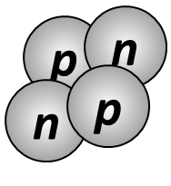
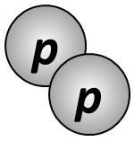
Table 2 - Comparison of Nuclear Forces in Helium-2 and Helium-4
$\begin{matrix}2 \\ 2\end{matrix}$He
$\begin{matrix}4 \\ 2\end{matrix}$He
Electromagnetic Force Repulsive Interactions |  | Strong Nuclear Force Attractive Interactions
p₁ with p₂ |  | p₁ with p₂
Electromagnetic Force Repulsive Interactions |  | Strong Nuclear Force Attractive Interactions
p₁ with p₂ |  | p₁ with p₂
 |  | n₁ with p₁
 |  | n₁ with p₂
 |  | n₂ with p₁
 |  | n₂ with p₂
 |  | n₁ with n₂
1 Repulsive Force
1 Attractive Force
Unstable
1 Repulsive Force
6 Attractive Forces
Stable

Slide 31
Question 5
Write a tally of all the attractive and repulsive interactions that occur in helium-4. Write a hypothesis as to why helium-4 is stable and helium-2 is not.
"Based on my tally, I hypothesize that if more nuclear forces are attractive than repulsive, then the nucleus will be stable. I hypothesize this because helium-2 is unstable with 1 repulsive force and 1 attractive force, while helium-4 is stable with 1 repulsive force and 6 attractive forces."
❺

Slide 32
Question 5
Write a tally of all the attractive and repulsive interactions that occur in helium-4. Write a hypothesis as to why helium-4 is stable and helium-2 is not.
❺
Grading
3 pts Correctly identifies the causative relationship (>attractive forces = stable), gives reason (Table 2), sufficient details, and statement is clear
2 pts Correctly identifies the causative relationship, gives reason, but minimal details and/or clarity.
1 pts Correctly identifies the causative relationship, but does not give reason.
0 pt Does not identify the causative relationship.

Slide 33
Finish Scoring
Add up all points
Return it to the author
Answer any questions they have
Save these sheets

Slide 34
General Advice
Remember This
Identify the causative relationship
Write your answer and the reason behind it
If . . . , then . . . , because . . .
Use their words and give details

Slide 35
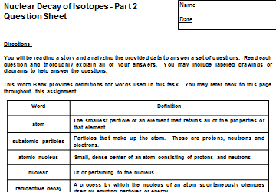
Next Class

Slide 36
Do Now
Aircraft can fly because air molecules flowing around their wings generate lift. Lift increases if the wings encounter more air molecules. Thus, the density of air is a key factor in lift.
When aircraft take off and land, they extend flaps on their wings to make the wings bigger, increase lift, and allow them to be airborne at lower speeds. These flaps can be extended different amounts depending on the lift needed.
Which plane will need to extend their flaps more, a plane taking off from Boston in the winter or same plane taking off from Miami in the summer? Write a prediction and justify your answer.

Slide 37
If a plane is taking off from Miami in the summer, then it will need to extend its flaps more than the same plane taking off from Boston in the winter,
This is because lift increases with air density and air density drops with increasing temperature.
Miami in the summer will have a higher temperature than Boston in the winter, thus the plane will need to extend its flaps more in Miami.

Slide 38
Introduction to Exercise

Slide 39
Informational Text
Every day, we get key information from reading
Acquiring information in this way is an important life skill that is crucial for success
A passage like this are called “informational text”
Examples include: labels, instructions, schedules, personal business documents, e-mails & more
As a result, education standards are demanding greatly increased focus on teaching “real world reading” skills in addition to other forms of literature
Today’s lesson is presented in information text

Slide 40
What Makes an Atom Radioactive?
Some atoms are completely stable and never break down
Some atoms are unstable and undergo radioactive decay (some quick, some slow)
What is it about some atoms that makes them stable, while making other atoms unstable
We will read an informational text that is intended to walk you through a rediscovery of the causes of nuclear decay of isotopes

Slide 45
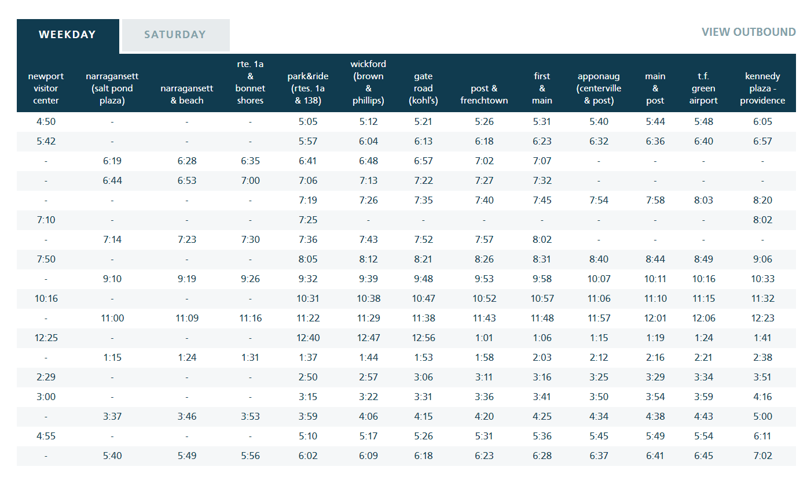

Slide 46
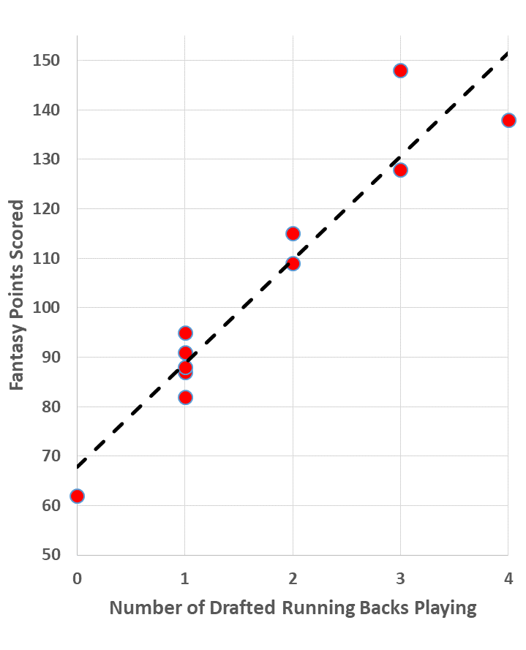
Do Now – Fantasy Football Analysis
My Fantasy Football team has been decimated by injuries to the running backs I drafted
This graph shows the points scored as a function of the number of drafted running backs playing a given week
On average, how many points can be attributed to each additional running back playing?
On average, how many points can I expect to get from players other than running backs?
Bonus: Explain the deviation at the top end of the line

Slide 47
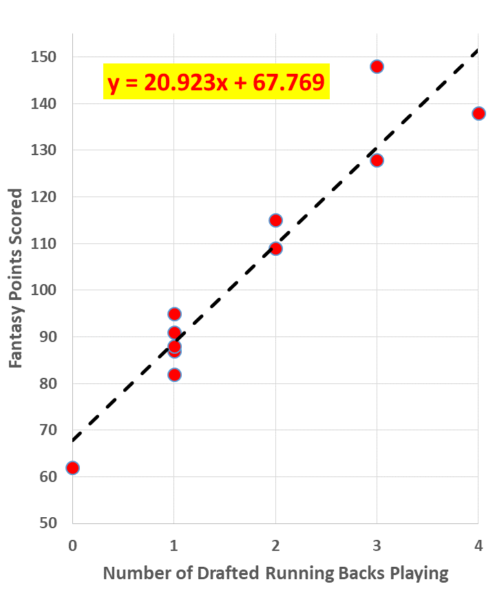
Do Now – Fantasy Football Analysis
On average, how many points can be attributed to each additional running back playing?
About 21 points
On average, how many points can I expect to get from players other than running backs?
Just under 70 points
Bonus: Explain the deviation at the top end of the line
My league only allows 2 RBs and 1 WR/RB, so the four RBs is essentially the same as three
Analysis of data using graphs or other tools provides us with ways to better understand and quantify things that interest us
Today you will be do Part 2 of Nuclear Decay of Isotopes using the same skills

