Slide 1
Nuclear Equations
Write this in your notes
SWBAT write balanced nuclear equations for radioactive decay reactions

Slide 2
Nuclear Equations
Write this in your notes
Nuclear equations describe the changes of nuclear reaction using atomic notation
EXAMPLE
$\begin{matrix}238 \\ 94\end{matrix}$Pu ª $\begin{matrix}234 \\ 92\end{matrix}$U$\begin{matrix}−2 \\ \end{matrix}$ + $\begin{matrix}4 \\ 2\end{matrix}$He$\begin{matrix}+2 \\ \end{matrix}$
Nuclear equations should be balanced for:
atomic number
mass number
charge

Slide 3
Nuclear Equations
A nuclear reaction is balanced when the sums of Z, A, & C are equal on both sides
Write this in your notes
$\begin{matrix}238 \\ 94\end{matrix}$Pu ª $\begin{matrix}234 \\ 92\end{matrix}$U$\begin{matrix}−2 \\ \end{matrix}$ + $\begin{matrix}4 \\ 2\end{matrix}$He$\begin{matrix}+2 \\ \end{matrix}$
Z = 94
A = 238
C = 0
Z = 92 + 2 = 94
A = 234 + 4 = 238
C = – 2 + 2 = 0

Slide 4
Nuclear Equations
If Z, A, & C are balanced, then p, n, & e will also be balanced
$\begin{matrix}238 \\ 94\end{matrix}$Pu ª $\begin{matrix}234 \\ 92\end{matrix}$U$\begin{matrix}−2 \\ \end{matrix}$ + $\begin{matrix}4 \\ 2\end{matrix}$He$\begin{matrix}+2 \\ \end{matrix}$
p = 94
n = 144
e = 94
p = 92
n = 142
e = 94
p = 2
n = 2
e = 0

Slide 5
Electrons & Charge
EXAMPLE
$\begin{matrix}238 \\ 94\end{matrix}$Pu ª $\begin{matrix}234 \\ 92\end{matrix}$U$\begin{matrix}−2 \\ \end{matrix}$ + $\begin{matrix}4 \\ 2\end{matrix}$He$\begin{matrix}+2 \\ \end{matrix}$
This nuclear equation is technically correct but it is unrealistic
Nuclear reactions involve much more energy than is necessary to transfer electrons between atoms
As a result, we can’t know where the electrons are
Nuclear reactions usually do not show charges or account for the electrons (except β particles)
Write this in your notes

Slide 6
234 + 4 = 238
$\begin{matrix}238 \\ 94\end{matrix}$Pu ª $\begin{matrix}234 \\ 92\end{matrix}$U$\begin{matrix}−2 \\ \end{matrix}$ + $\begin{matrix}4 \\ 2\end{matrix}$He$\begin{matrix}+2 \\ \end{matrix}$
$\begin{matrix}238 \\ 94\end{matrix}$Pu ª $\begin{matrix}234 \\ 92\end{matrix}$U$\begin{matrix}−2 \\ \end{matrix}$ + $\begin{matrix}4 \\ 2\end{matrix}$He$\begin{matrix}+2 \\ \end{matrix}$
$\begin{matrix}238 \\ 94\end{matrix}$Pu ª $\begin{matrix}234 \\ 92\end{matrix}$U$\begin{matrix}−2 \\ \end{matrix}$ + $\begin{matrix}4 \\ 2\end{matrix}$He$\begin{matrix}+2 \\ \end{matrix}$
92 + 2 =94
To balance nuclear equations, make sure Z & A are equal on both sides
Write this in your notes

Slide 7
Demonstration
Write the balanced nuclear equation for the decay of chlorine-38 into argon-38 and a beta particle.

Slide 8
Typical Decay Problems
Write this in your notes
At minimum, the nuclear equation for a radioactive decay has the following components
parent nuclide
daughter
nuclide
+
radiation particle

Slide 9
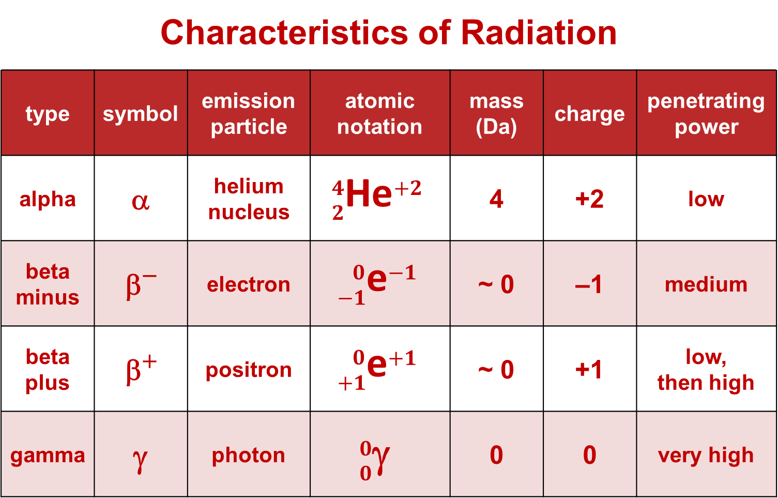
Demonstration
Write the balanced nuclear equation for the decay of chlorine-38 into argon-38 and a beta particle.
$\begin{matrix}38 \\ 17\end{matrix}$Cl ª $\begin{matrix}38 \\ 18\end{matrix}$Ar + $\begin{matrix}0 \\ −1\end{matrix}$e

Slide 10
Check for Understanding 1
Write the balanced nuclear equation for the decay of polonium-218 into astatine-218 and a beta particle.
$\begin{matrix}218 \\ 84\end{matrix}$Po ª $\begin{matrix}218 \\ 85\end{matrix}$At + $\begin{matrix}0 \\ −1\end{matrix}$e

Slide 11
Check for Understanding 2
Write the balanced nuclear equation for the decay of manganese-50 into chromium-50 and a positron
$\begin{matrix}50 \\ 25\end{matrix}$Mn ª $\begin{matrix}50 \\ 24\end{matrix}$Cr + $\begin{matrix}0 \\ +1\end{matrix}$e

Slide 12
Check for Understanding 3
Write the balanced nuclear equation for the decay of nickel-60 into nickel-60 and a gamma photon
$\begin{matrix}60 \\ 28\end{matrix}$Ni ª $\begin{matrix}60 \\ 28\end{matrix}$Ni + $\begin{matrix}0 \\ 0\end{matrix}$γ

Slide 13
Check for Understanding 4
Write the balanced nuclear equation for the decay of plutonium-242 into uranium-238 and an alpha particle
$\begin{matrix}242 \\ 94\end{matrix}$Pu ª $\begin{matrix}238 \\ 92\end{matrix}$U + $\begin{matrix}4 \\ 2\end{matrix}$He

Slide 14
Check for Understanding 5
Some radioactive nuclides go through several decay steps to become more stable. Write the balanced nuclear equation for the decay of uranium-238 into radium-226, three alpha particles and two beta particles
$\begin{matrix}238 \\ 92\end{matrix}$U ª $\begin{matrix}226 \\ 88\end{matrix}$Ra + 3 $\begin{matrix}4 \\ 2\end{matrix}$He + 2$\begin{matrix} 0 \\ −1\end{matrix}$e

Slide 15
Finding an Unknown
When fluorine-18 undergoes radioactive decay, it produces a positron and another atom. Write a balanced nuclear equation which identifies the other atom.
18 = A + 0
18 = A
$\begin{matrix}18 \\ 9\end{matrix}$F ª + $\begin{matrix}0 \\ 1\end{matrix}$e
18
O
$\begin{matrix}18 \\ 9\end{matrix}$F ª $\begin{matrix}18 \\ 8\end{matrix}$O + $\begin{matrix}0 \\ 1\end{matrix}$e
8
9 = Z + 1
8 = Z

Slide 16
Check for Understanding 6
When carbon-14 undergoes radioactive decay, it produces a beta particle and another atom. Write a balanced nuclear equation which identifies the other atom.
14 = A + 0
14 = A
$\begin{matrix}14 \\ 6\end{matrix}$C ª + $\begin{matrix} 0 \\ −1\end{matrix}$e
$\begin{matrix}14 \\ 6\end{matrix}$C ª $\begin{matrix}14 \\ 7\end{matrix}$N + $\begin{matrix} 0 \\ −1\end{matrix}$e
6 = Z - 1
7 = Z
X = N

Slide 17
Check for Understanding 7
To become stable, uranium-234 goes through a number of alpha decays to become lead-214. How many alpha decays does lead go through?
$\begin{matrix}234 \\ 92\end{matrix}$U ª $\begin{matrix}214 \\ 82\end{matrix}$Pb + 5 $\begin{matrix}4 \\ 2\end{matrix}$He

Slide 18
Check for Understanding 8
A radioactive nuclide becomes stable by suffering an alpha decay, two beta minus decays, and finally another alpha decay. The final nuclide is lead-208. What is the parent nuclide?
$\begin{matrix}216 \\ 84 \end{matrix}$Po ª $\begin{matrix}208 \\ 82\end{matrix}$Pb + 2 $\begin{matrix}4 \\ 2\end{matrix}$He + 2$\begin{matrix} 0 \\ −1\end{matrix}$e

Slide 19
Backup Slides

Slide 20
Nuclear Equations
Write this in your notes
Nuclear equations describe the changes of nuclear reaction using atomic notation
$\begin{matrix}238 \\ 94\end{matrix}$Pu ª $\begin{matrix}234 \\ 92\end{matrix}$U$\begin{matrix}−2 \\ \end{matrix}$ + $\begin{matrix}4 \\ 2\end{matrix}$He$\begin{matrix}+2 \\ \end{matrix}$
Np = 94 |  | Np = 92 |  | Np = 2
Nn = 144 |  | Nn = 142 |  | Nn = 2
Ne = 94 |  | Ne = 94 |  | Ne = 0

Slide 21
Nuclear Equations
Reactant atom(s) are called parents
Product atom(s) are call daughters
Write this in your notes
$\begin{matrix}238 \\ 94\end{matrix}$Pu ª $\begin{matrix}234 \\ 92\end{matrix}$U$\begin{matrix}−2 \\ \end{matrix}$ + $\begin{matrix}4 \\ 2\end{matrix}$He$\begin{matrix}+2 \\ \end{matrix}$
Write this in your notes
Nuclear equations should be balanced for:
atomic number
mass number
charge
Nuclear equations sometimes do not track electrons

Slide 22
Stable and Radioactive Nuclides
Write this in your notes
SWBAT
identify the characteristics of stable nuclides
identify the favored decay pathway(s) for radioactive nuclides
predict the decay pathways for nuclides

Slide 23
Kinetics of Radioactive Decay
Write this in your notes
SWBAT explain the kinetics of radioactive decay and complete half-life calculations.

Slide 24
Nuclear Fission & Fusion
Write this in your notes
SWBAT
explain the concepts of fission & fusion
predict the favored pathway
write balanced equations for fission & fusion reactions

Slide 25
Radioactive Decay Pathways
name | impact | diagram
alpha | lose 2p & 2n
beta minus | change n into p
beta plus | change p into n
gamma | lose energy

