Slide 1
Radioactive Decay
Write this in your notes
SWBAT describe radioactive decay and describe the four major radioactive decay pathways

Slide 2
Writing Greek Letters
alpha
gamma
If I can’t read it, I’ll mark it wrong!

Slide 3
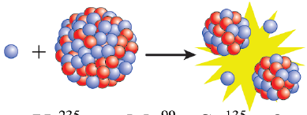
Three Types of Nuclear Reactions
Radioactive Decay - a process by which a nucleus spontaneously changes itself by emitting particles or energy.
Nuclear Fission - a process by which a nucleus splits into two or more smaller parts
Nuclear fusion - a process by which two nuclei join together into one larger atom

Slide 4
Radioactive Decay - a process by which a nucleus spontaneously changes itself by emitting particles or energy.

Slide 5
Key Elements of Radioactive Decay
Write this in your notes
Only one parent nuclide
No other parent atoms
No particles or triggers
Only one daughter nuclide
At least one radiation particle
Other daughter particles possible
The reaction is spontaneous
No initiation required

Slide 6
Write this in your notes
Radioactive Decay Pathways
name | impact | diagram

Slide 7
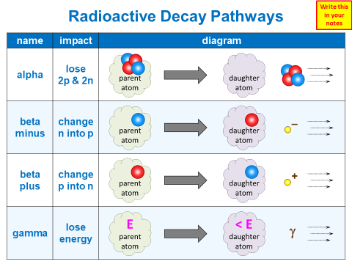
Legend for Table
Write this in your notes
proton
neutron
–
electron
+
positron
γ
gamma photon

Slide 8
Legend for Table
Wait . . .
I’m not Grace
I don’t have colored pencils for taking notes!
How can I do this with a pen?
proton
neutron
–
electron
+
positron
γ
gamma photon

Slide 9
Legend for Table
proton
p
proton
neutron
n
neutron
–
electron
e–
electron
+
positron
e⁺
positron
γ
γ
gamma photon
gamma photon

Slide 10
Write this in your notes
Radioactive Decay Pathways
name | impact | diagram

Slide 11
Write this in your notes
Radioactive Decay Pathways
name | impact | diagram
alpha

Slide 12
Write this in your notes
Radioactive Decay Pathways
name | impact | diagram
alpha | lose 2p & 2n

Slide 13
Write this in your notes
Radioactive Decay Pathways
name | impact | diagram
alpha | lose 2p & 2n
beta minus

Slide 14
Write this in your notes
Radioactive Decay Pathways
name | impact | diagram
alpha | lose 2p & 2n
beta minus | change n into p

Slide 15
Write this in your notes
Radioactive Decay Pathways
name | impact | diagram
alpha | lose 2p & 2n
beta minus | change n into p
beta plus

Slide 16
Write this in your notes
Radioactive Decay Pathways
name | impact | diagram
alpha | lose 2p & 2n
beta minus | change n into p
beta plus | change p into n

Slide 17
Write this in your notes
Radioactive Decay Pathways
name | impact | diagram
alpha | lose 2p & 2n
beta minus | change n into p
beta plus | change p into n
gamma

Slide 18
Write this in your notes
Radioactive Decay Pathways
name | impact | diagram
alpha | lose 2p & 2n
beta minus | change n into p
beta plus | change p into n
gamma | lose energy

Slide 19
Key Concept
Write this in your notes
Atoms undergo radioactive decay to become more stable
They choose a pathway that addresses the cause of instability

Slide 20
Check for Understanding 1
D
C
An atom is unstable because it has too many neutrons and not enough protons. What decay pathway will it use to make it more stable?
Beta minus which converts a neutron into a proton

Slide 21
Check for Understanding 2
B
C
An atom has a good number of protons and neutrons, but the nucleus has too much energy. What decay pathway will it use to make it more stable?
Gamma decay which lowers the energy of the nucleus

Slide 22
Check for Understanding 3
E
C
An atom is unstable because it’s mass number is too high. What decay pathway will it use to make it more stable?
Alpha decay which lowers the mass number by 4

Slide 23
Write this in your notes
Characteristics of Radiation
type | symbol | emission particle | atomic notation | mass (Da) | charge | penetrating power
alpha
beta minus
beta plus
gamma

Slide 24
Alpha Decay
symbol: α
emission particle: helium nucleus
atomic notation: $\begin{matrix}4 \\ 2\end{matrix}\text{He}\begin{matrix}+2 \\ \end{matrix}$
mass: 4 Da
charge: +2
penetrating power:

Slide 25
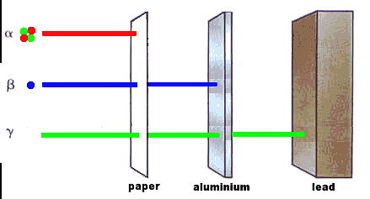
Penetrating Power
Write this in your notes
Different types of radiation have different abilities to pass through materials
This property is called “penetrating power”

Slide 26
Alpha Decay
symbol: α
emission particle: helium nucleus
atomic notation: $\begin{matrix}4 \\ 2\end{matrix}\text{He}\begin{matrix}+2 \\ \end{matrix}$
mass: 4 Da
charge: +2
penetrating power: low

Slide 27
Write this in your notes
Characteristics of Radiation
type | symbol | emission particle | atomic notation | mass (Da) | charge | penetrating power
alpha | α | helium nucleus | $$\begin{matrix}4 \\ 2\end{matrix}\text{He}\begin{matrix}+2 \\ \end{matrix}$$ | 4 | +2 | low
beta minus
beta plus
gamma

Slide 28
Beta Minus Decay
Wait . . .
How can a neutron change into a proton?

Slide 29
Neutron to Proton?
Protons and neutrons are actually made up of smaller particles called quarks
D
D
U
U
U
D

Slide 30
Quarks
Quarks are elementary particles that can only be observed in composite particles like the proton and neutron
D
D
U
U
U
D

Slide 31
Quarks
Protons have 2 up & 1 down quarks
Neutrons have 1 up & 2 down quarks
D
D
U
U
U
D

Slide 32
Quarks
Quarks have properties that determine the overall properties of protons & neutrons
D
–⅓
D
–⅓
U
+⅔
U
U
+⅔
+⅔
D
–⅓

Slide 33
A neutron can change into a proton
by converting one down quark into an up quark

Slide 34
This conversion is mediated by
weak nuclear force through a W – boson particle
W –
W – boson
(force particle for weak nuclear force)

Slide 35
The W – boson itself suffers decay to
produce an electron and an electron antineutrino
Beta Particle – an electron produced in beta minus decay
Write this in your notes
W –
e–
ν_{e}
W – boson
(force particle for weak nuclear force)
electron
electron
antineutrino
Because it was easier to detect, the electron was first thought to be the only emission particle

Slide 36
Beta Minus Decay
symbol: β⁻
emission particle: electron
atomic notation: $\begin{matrix} 0 \\ −1\end{matrix}\text{e}\begin{matrix}−1 \\ \end{matrix}$
Wait . . .
How can an electron have a negative atomic number?

Slide 37
Negative Atomic Number?
An electron does not have any protons, much less anti-protons
However, a beta particle is given a negative atomic number to account for the creation of a proton
The negative atomic number is on a beta particle purely for particle accounting

Slide 38
Beta Minus Decay
symbol: β⁻
emission particle: electron
atomic notation: $\begin{matrix} 0 \\ −1\end{matrix}\text{e}\begin{matrix}−1 \\ \end{matrix}$
mass: 1/1840th of a Da
charge: –1
penetrating power: medium

Slide 39
Write this in your notes
Characteristics of Radiation
type | symbol | emission particle | atomic notation | mass (Da) | charge | penetrating power
alpha | α | helium nucleus | $$\begin{matrix}4 \\ 2\end{matrix}\text{He}\begin{matrix}+2 \\ \end{matrix}$$ | 4 | +2 | low
beta minus | β⁻ | electron | $$\begin{matrix} 0 \\ −1\end{matrix}\text{e}\begin{matrix}−1 \\ \end{matrix}$$ | ~ 0 | –1 | medium
beta plus
gamma

Slide 40
Beta Plus Decay
symbol: β⁺
emission particle: positron
atomic notation: $\begin{matrix} 0 \\ +1\end{matrix}\text{e}\begin{matrix}+1 \\ \end{matrix}$
mass: 1/1840th of a Da
charge: +1
penetrating power: low, then high

Slide 41
A proton changes an up quark
to a down quark and becomes a neutron

Slide 42
This conversion is also mediated by
weak nuclear force, but this time via a W⁺ boson
W ⁺
e⁺
ν_{e}
W ⁺ boson
(force particle for weak nuclear force)
positron
electron
neutrino
The W⁺ boson suffers decay, this time creating
a positron and an electron neutrino

Slide 43
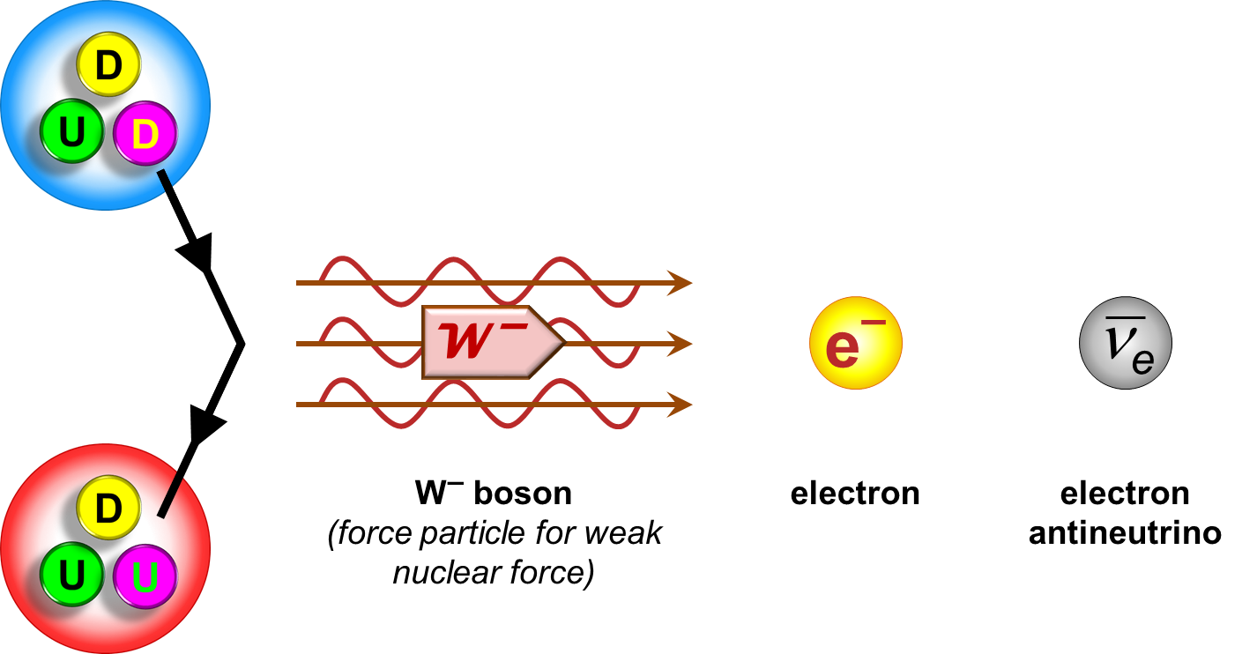
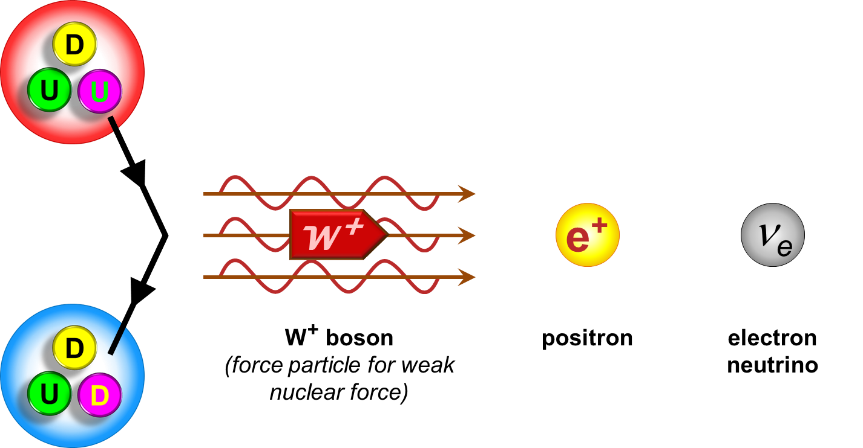
β⁻ and β⁺ are inverse processes

Slide 44
Positron
Write this in your notes
e⁺
e–
A positron is an antimatter particle
It is the partner to the electron, a matter particle
If the two collide, it produces a matter-antimatter reaction
Both particles are annihilated (converted to pure energy)

Slide 45
Positron
Write this in your notes
γ
γ
A positron is an antimatter particle
It is the partner to the electron, a matter particle
If the two collide, it produces a matter-antimatter reaction
Both particles are annihilated (converted to pure energy)
The energy is converted into high energy gamma photons
The positron does not penetrate far, but gamma photons have very high penetration
β⁺ is also called positron emission

Slide 46
Write this in your notes
Characteristics of Radiation
type | symbol | emission particle | atomic notation | mass (Da) | charge | penetrating power
alpha | α | helium nucleus | $$\begin{matrix}4 \\ 2\end{matrix}\text{He}\begin{matrix}+2 \\ \end{matrix}$$ | 4 | +2 | low
beta minus | β⁻ | electron | $$\begin{matrix} 0 \\ −1\end{matrix}\text{e}\begin{matrix}−1 \\ \end{matrix}$$ | ~ 0 | –1 | medium
beta plus | β⁺ | positron | $$\begin{matrix} 0 \\ +1\end{matrix}\text{e}\begin{matrix}+1 \\ \end{matrix}$$ | ~ 0 | +1 | low, then high
gamma

Slide 47
Gamma Decay
symbol: $\text{g}$
emission particle: photon
atomic notation: $\begin{matrix}0 \\ 0\end{matrix}\text{g}$
mass: 0
charge: 0
penetrating power: very high

Slide 48
Write this in your notes
Characteristics of Radiation
type | symbol | emission particle | atomic notation | mass (Da) | charge | penetrating power
alpha | α | helium nucleus | $$\begin{matrix}4 \\ 2\end{matrix}\text{He}\begin{matrix}+2 \\ \end{matrix}$$ | 4 | +2 | low
beta minus | β⁻ | electron | $$\begin{matrix} 0 \\ −1\end{matrix}\text{e}\begin{matrix}−1 \\ \end{matrix}$$ | ~ 0 | –1 | medium
beta plus | β⁺ | positron | $$\begin{matrix} 0 \\ +1\end{matrix}\text{e}\begin{matrix}+1 \\ \end{matrix}$$ | ~ 0 | +1 | low, then high
gamma | γ | photon | $$\begin{matrix}0 \\ 0\end{matrix}\text{g}$$ | 0 | 0 | very high

Slide 49
Check for Understanding 4
Anthony and Sarah were trying to identify the type of radiation coming from the decay of barium-137. They found that the radiation penetrated through paper, aluminum and even thin sheets of lead.
Anthony said, “Wow, that radiation has very high penetrating power. What type of radiation it is?”
Sarah replied, “Oh Anthony, I can’t believe I let you be my lab partner. You’d know if you looked at your class notes!”
What type of radiation is it?
Gamma radiation which has very high penetrating power

Slide 50
Check for Understanding 5
Anthony and Sarah were trying to identify the type of radiation coming from the decay of carbon-14. They found that the radiation was attracted to the positive pole of a magnet.
“Look at that!”, exclaimed Anthony, “I suppose you’re going to tell me you know the radiation type again.”
“Of course,” replied Sarah, “There is only one type of radiation that could behave that way.”
What type of radiation is it?
Beta minus which releases an electron
The electron is negatively charged, so it is attracted to the positive pole of a magnet

Slide 51
Check for Understanding 6
Anthony and Sarah were writing the their lab report.
“I have to explain why the carbon-14 went through beta minus decay,” said Anthony, “I guess it just wanted to get rid of an electron, right?”
“You really need to study if you want to get test grades as good as mine!” replied Sarah patiently, “We learned that atoms choose a radioactive decay path that addresses the cause of instability.”
Why did carbon-14 go through beta minus decay?
Beta minus decay changes a neutron to a proton
Carbon-14 must have needed to reduce neutrons, increase protons, or both.

Slide 52
Backup Slides

Slide 53
Stable and Radioactive Nuclides
Write this in your notes
SWBAT
identify the characteristics of stable nuclides
identify the favored decay pathway(s) for radioactive nuclides
predict the decay pathways for nuclides

Slide 54
Kinetics of Radioactive Decay
Write this in your notes
SWBAT explain the kinetics of radioactive decay and complete half-life calculations.

Slide 55
Nuclear Fission & Fusion
Write this in your notes
SWBAT
explain the concepts of fission & fusion
predict the favored pathway
write balanced equations for fission & fusion reactions

Slide 56
Standard Model

Slide 57
Write this in your notes
Radioactive Decay Pathways
name | impact | diagram
alpha | lose 2p & 2n
beta minus | change n into p
beta plus | change p into n
gamma | lose energy

