Slide 1
Early Enrollment Program
Application forms in black basket
This is a 4 credit class
Call #: 12361
Course Title: General Chemistry I
Application deadline is October 15
Return application form to Mrs. Nobrega

Slide 2
Homework on Matter
Lesson | Problems
Introduction to Matter | Chapter 3: 17, 39, 60, 62, 67
Physical & Chemical Changes | Chapter 3: 12, 33, 34, 41, 45
Three Laws of Matter | Chapter 3: 27, 55, 71, 73, 75
Homework is due today
Before turning in your homework, note any questions you would like to have reviewed in class

Slide 3
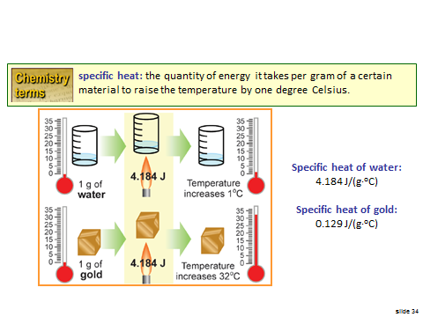
Last Class

Slide 4
Specific Heat Calculations
Write this in your notes
SWBAT complete calculations which use specific heat to relate heat to temperature changes

Slide 5
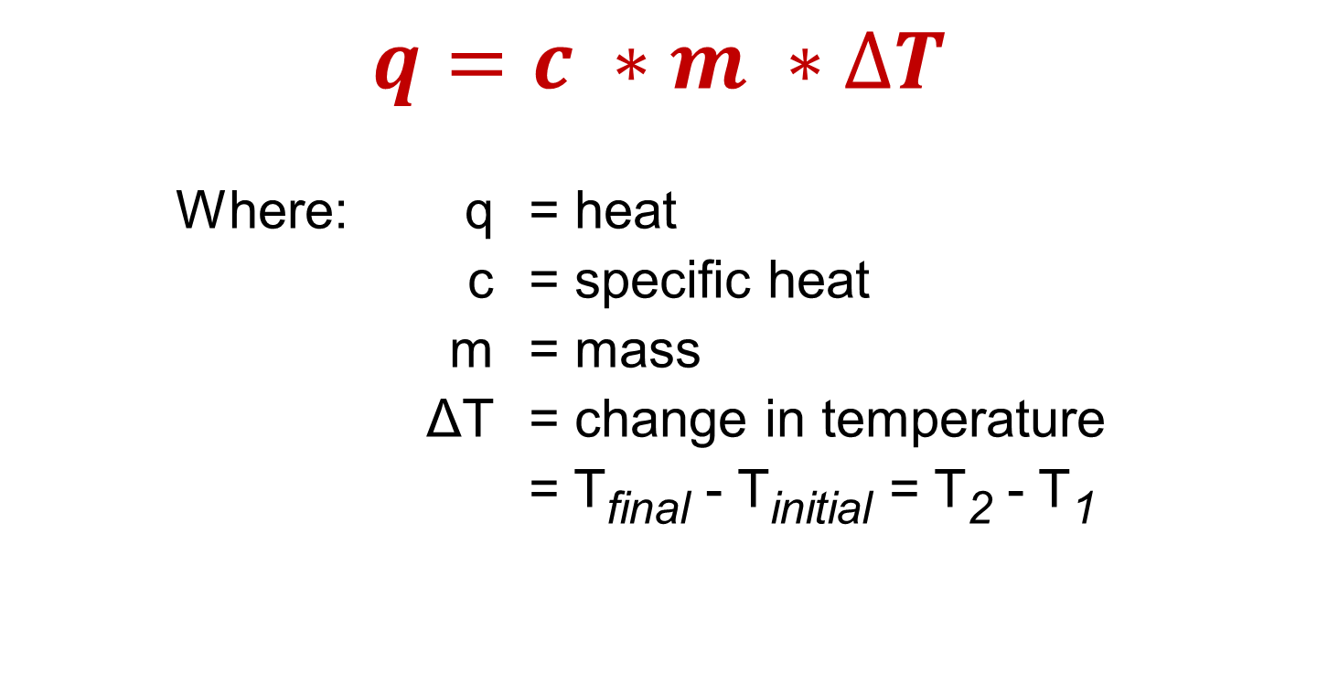
Relationship between Heat and Temperature
Review
$$q=c ∗m ∗∆T$$
Where: q = heat
c = specific heat
m = mass
ΔT = change in temperature
= T_{final} - T_{initial} = T₂ - T₁

Slide 6


What is Specific Heat?
Review
The amount of heat required to raise the temperature of one gram of substance by one degree Celsius
Specific heat can vary dramatically between different substances
Symbol is "c"
Units are cal/g°C or J/g°C
By definition, the specific heat of water is 1 cal/g°C or 4.184 J/g°C
Correction
$$\frac{cal}{g ℃}$$
$$\frac{J}{g ℃}$$

Slide 7
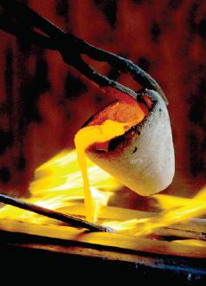
Sample Calculation
A metal-working process needs to heat steel from room temperature (22ºC) to 2,300ºC. If the mass of steel is 120 g, how much heat is required? The specific heat of steel is 0.470 J/g°C
$$q=c ∗m ∗∆T$$
$$q=(0.470 J/g\text{°}\text{C}\text{)}∗(120 g) ∗(23\text{00-22}\text{°}\text{C}\text{)}$$
$$q=128,479.2 J$$
$$\text{⇒} 130,000 J$$

Slide 8
Solving Problems on Heat & Temperature
$$q=c ∗m ∗∆T$$
When given a problem using this equation, one of the four variables will be missing.
To solve, we just need basic algebra
In the beginning, it is useful to methodically identify each given and follow the units to make sure nothing is missed

Slide 9
Solving Heat-Temperature Problems
$$q=c ∗m ∗∆T$$
Find q
Find c, m or ΔT
Find T₂ or T₁

Slide 10
Solving Heat-Temperature Problems
$$q=c ∗m ∗∆T$$
Find q
Find c, m or ΔT
Find T₂ or T₁

Slide 11
A jeweler needs to warm a silver ring by 40°C so he can reshape it. If the ring weighs 18 g and the specific heat of silver 0.235 J/g°C, how much heat will the jeweler need to add?
$$q=c ∗m ∗∆T$$
$$q=(0.235 J/g\text{°}\text{C}\text{)}∗(18 g) ∗(40\text{°}\text{C}\text{)}$$
$$q=169. 2 J$$
$$\text{⇒} 170 J$$
c, m, ΔT are given
find q

Slide 12
To remove a large window from a building, it must be shrunk 1 mm by cooling from 30°C to 22°C. If the window weighs 6.2 kg and the specific heat of glass is 0.840 J/g°C, how much heat will need to be removed?
$$q=c ∗m ∗∆T$$
$$q=(0.840 J/g\text{°}\text{C}\text{)}∗(6200 g) ∗(22 −30\text{°}\text{C}\text{)}$$
$$q=−41,664 J$$
$$\text{⇒} −42,000 J$$
c, m, ΔT are given
find q
must convert m
ΔT is negative

Slide 13
Solving Heat-Temperature Problems
$$q=c ∗m ∗∆T$$
Find q
Find c, m or ΔT
Find T₂ or T₁

Slide 14
A balloon is warmed from 82°C to 106°C by the addition of 460 J of heat. If the specific heat of air is 1.020 J/g°C, what is the mass of the air in the balloon?
$$q=c ∗m ∗∆T$$
$$460 J=(1.020 J/g\text{°}\text{C}\text{)}∗(m) ∗(106 −82\text{°}\text{C}\text{)}$$
$$\frac{460 J}{(1.020\frac{J}{g\text{°}\text{C}})(24\text{°}\text{C})}=m$$
$$=18.79 g$$
$$\text{⇒} 19 g$$
c, ΔT, q are given
find m

Slide 15
A radiator circulates 4200 g of ethylene glycol to cool a diesel engine. In one case, the radiator cools the engine from 96°C to 84°C by the removing 110,880 J of heat. What is the specific heat of ethylene glycol?
$$q=c ∗m ∗∆T$$
$$−110,880 J=(c\text{)}∗(4200g) ∗(84 −96\text{°}\text{C}\text{)}$$
$$\frac{−110,880 J}{(4200 g)(−12\text{°}\text{C})}=c$$
$$=2.2 \text{J}\text{/}\text{g}\text{°}\text{C}$$
m, ΔT, q are given
find c
ΔT is negative
q is negative

Slide 16
Solving Heat-Temperature Problems
$$q=c ∗m ∗∆T$$
Find q
Find c, m or ΔT
Find T₂ or T₁

Slide 17
A 613 g bar of iron is transferred into a blast furnace where 350,000 J of heat is applied. If the iron bar started at 25°C, what was the temperature after all the heat was absorbed. The specific heat of iron is 0.444 J/g°C.
$$q=c ∗m ∗∆T$$
$$350,000 J=(0.444 \text{J}\text{/}\text{g}\text{°}\text{C}\text{)}∗(613g) ∗(T2 −25\text{°}\text{C}\text{)}$$
$$\frac{350,000 J}{(0.444 \text{J}\text{/}\text{g}\text{°}\text{C})(613g)}=(T2 −25\text{°}\text{C}\text{)}$$
$$\frac{350,000 J}{(0.444 \text{J}\text{/}\text{g}\text{°}\text{C})(613g)}+25\text{°}\text{C}=T2$$
$$=1311\text{°}\text{C}$$
$$\text{⇒} 1300\text{°}\text{C}$$
q, c, m T₁ are given
find T₂

Slide 18
Homework
Worksheet on Specific Heat
We will start this in class. Anything not complete by the end of class needs to be done for homework

Slide 19
Relationship between Heat and Temperature
Review
$$q=c ∗m ∗∆T$$
Where: q = heat
c = specific heat
m = mass
ΔT = change in temperature
= T_{final} - T_{initial} = T₂ - T₁

