Slide 1
Identifying Atoms
Write this in your notes
Write this in your notes
SWBAT identify atoms by their names, subatomic particles and masses by using:
element names
atomic symbols
atomic number
charge
mass number
atomic mass
standard atomic weight

Slide 2
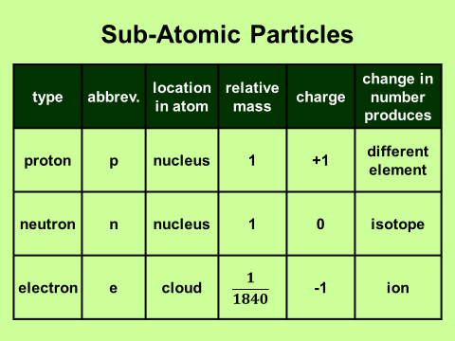
We have learned . . .

Slide 3
What we will learn . . .
How to find and use the names & symbols for different elements
How an atom’s composition is indicated by the measured quantities of atomic number, charge, and mass
The various ways an atom’s mass is quantified

Slide 4
Elements
Elements are atoms with the same number of protons.
Some of these elements have been known since antiquity, long before the concept of atoms existed.
During the Age of Enlightenment (1700’s), discovery of new elements accelerated as the foundations of the atomic theory were being established
This continues today. Five new elements have been discovered since 2000.

Slide 5
Periodic Tables
Save your periodic tables
You will need them for tests
Do not write anything on them

Slide 6
Each tile provides information on a single element

Slide 7
Write this in your notes
Atomic Number
Atomic Symbol
Element Name
(do not capitalize)
Standard Atomic Weight

Slide 8
Write this in your notes
Atomic Symbol
Element Name
(do not capitalize)
Atomic Number

Slide 9
Check for Understanding 1
1) What element has the atomic number of 33?
arsenic
2) What is the atomic number of uranium?
92
3) What is the standard atomic weight of zirconium?
91.224
4) What element has the atomic symbol of Os?
osmium
5) What is the atomic number for Db?
105

Slide 10
Atomic Symbols
Write this in your notes
Definition: a one or two letter abbreviation for the element
Capitalization counts!
First letter is always capitalized
Second letter is always lower case

Slide 11
Capitalization Counts
Co means cobalt
Pb means lead
CO means carbon & oxygen
PB means phosphorus and boron

Slide 12
Capitalization Counts
Cl means chlorine
Cl means carbon & iodine
In this class, Cl will always mean chlorine
Write this in your notes

Slide 13
Atomic Symbols
Write this in your notes
Definition: a one or two letter abbreviation for the element
Capitalization counts!
First letter is always capitalized
Second letter is always lower case
Most atomic symbols are based on the element’s name in English

Slide 14
Symbols based on English Names
Symbol for
uranium
Symbol for
titanium
Symbol for
magnesium

Slide 15
Atomic Symbols
Write this in your notes
Definition: a one or two letter abbreviation for the element
Capitalization counts!
First letter is always capitalized
Second letter is always lower case
Most atomic symbols are based on the element’s name in English
Eleven atomic symbols are based on the element’s name in Latin
These symbols are shaded on the element list

Slide 16
Symbols based on Latin Names
Symbol for
gold
Symbol for
antimony
Symbol for
tungsten

Slide 17
English Name | Atomic Symbol | Latin Name
Antimony | Sb | Stibium
Copper | Cu | Cuprum
Gold | Au | Aurum
Iron | Fe | Ferrum
Lead | Pb | Plumbum
Mercury | Hg | Hydragyrum
Potassium | K | Kalium
Silver | Ag | Argentum
Sodium | Na | Natrium
Tin | Sn | Stannum
Tungsten | W | Wolfram

Slide 18
Elements with atomic symbols based on Latin names are shaded on the alphabetical list of elements

Slide 19
Latin Live On

Slide 20
The late 1400’s and early 1500’s was marked by European exploration of the New World
This became known as the “Age of Exploration”

Slide 21
Sea travel across the Atlantic ocean was extremely dangerous and many were lost
Explorers could only be recruited for such voyages with the promise of huge fortune

Slide 22
The New World natives were generally friendly and willing to barter with food and common items
This, however, was not what interested the explorers

Slide 23
The explorers were captivated by the silver and gold jewelry worn by the natives
The explorers asked where so much silver and gold was found

Slide 24
The natives spoke of an Incan land where silver nuggets lay all over a huge mountain
They showed the explorers silver nuggets size of plums

Slide 25
This legendary place became known as
Sierra de la Plata
(silver mountain)

Slide 26
Explorers carried out extensive searches throughout Patagonia
Unimaginable quantities of silver were found, and explorers got their fortunes
But Sierra de la Plata was never found.
Historians now believe the legend has its origins in the abundant silver mines in Cerro Rico de Potosí, shown here in 1715 lithograph

Slide 27
Yet the myth of a land rich with silver lives on
The South American country that was later formed was called “silver land”, but by using argentum, the Latin name for silver
What country is this?
ARGENTINA

Slide 28
Check for Understanding 2
1) What is the difference between In and IN?
In = indium, IN = iodine & nitrogen
2) Rf is the atomic symbol for what element?
rutherfordium
3) Rf is named after a famous scientist. Describe the experiment this scientist conducted.
Rutherford discovered the nucleus and proton by showing that α-particles rarely bounced off a thin gold foil
4) In ancient Rome, those who worked on water pipes became known as “plumbers” because of the low melting metal they used in their trade. What is this element?
lead (plumbum in Latin)

Slide 29
Identifying Atoms
SWBAT identify atoms by their names, subatomic particles and masses by using:
element names
atomic symbols
atomic number
charge
mass number
atomic mass
standard atomic weight

Slide 30
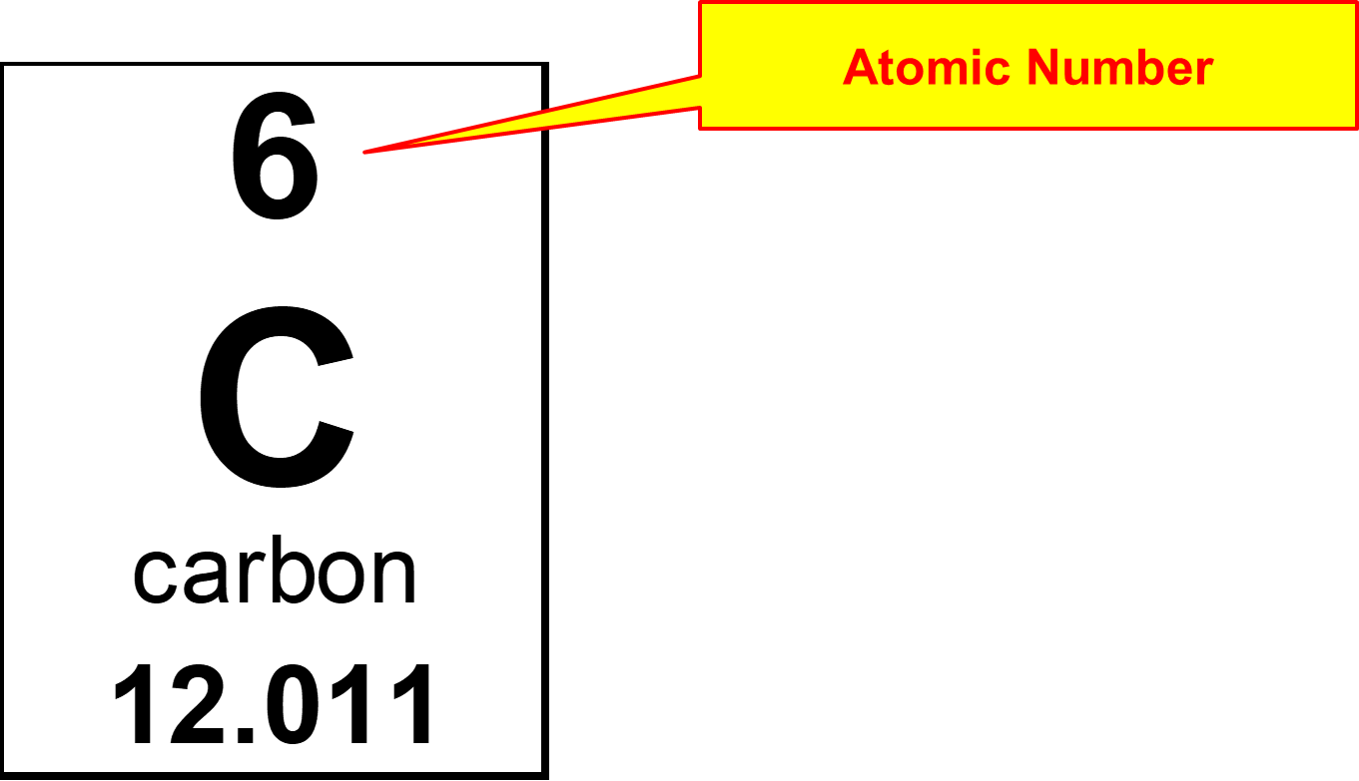
Atomic Number
Write this in your notes
Atomic number: the number of protons in an atom
The number of protons is what defines elements
As a result, the atomic number is a unique identifier for each element.

Slide 31
Charge
Write this in your notes
Charge: the number that indicates the balance (or imbalance) of protons & electrons
The charge provides insight into an atom’s stability and reactivity
Na¹⁺
O²⁻

Slide 32
Mass Number
Write this in your notes
Mass Number: the number of protons and neutrons in an atom
Since 99.9% of an atom’s mass is from the protons and neutrons, the mass number is a quick approximation of an atom’s mass
mass number
12
mass number
13
mass number
14

Slide 33
Symbols & Equations
Write this in your notes
number | symbol | equation
atomic number | Z | Z = p
charge | C | C = p – e
mass number | A | A = p + n

Slide 34
Converting between ZCA & pne
If we know the atomic number (Z), the charge (C), and the mass number (A), we can calculate the number of protons (p), neutrons (n) and electrons (e)

Slide 35
Convert ZCA to pen
Write this in your notes
Z = p
28 = p
Z = 28
C = +2
A = 59
p = 28
e = 26
n = 31
C = p – e
2 = 28 – e
-26 = - e
26 = e
A = p + n
59 = 28 + n
31 = n

Slide 36
Going the Other Way
Write this in your notes
Z = p
Z = 16
p = 16
e = 18
n = 17
Z = 16
C = –2
A = 33
C = p – e
C = 16 – 18
C = –2
A = p + n
A = 16 + 17
A = 33

Slide 37
Check for Understanding 3
Z = p
Z = 19
p = 19
e = 18
n = 20
Z = 19
C = 1
A = 39
C = p – e
C = 19 – 18
C = 1
A = p + n
A = 19 + 20
A = 39

Slide 38
Check for Understanding 4
Z = p
22 = p
Z = 22
C = 4
A = 48
p = 22
e = 18
n = 26
C = p – e
4 = 22 – e
-18 = - e
18 = e
A = p + n
48 = 22 + n
26 = n

Slide 39
Symbols & Equations
REVIEW
number | symbol | equation
atomic number | Z | Z = p
charge | C | C = p – e
mass number | A | A = p + n

Slide 40
Do Now
Find the number of protons, neutrons & electrons:
atomic number = 8 p =
charge = –2 n =
mass number = 19 e =
Find Z, C and A:
p = 26 Z =
n = 29 C =
e = 23 A =
What are these two elements?
oxygen and iron
8
9
11
26
+3
55

Slide 41
Identifying Atoms
SWBAT identify atoms by their names, subatomic particles and masses by using:
element names
atomic symbols
atomic number
charge
mass number
atomic mass
standard atomic weight

Slide 42
Mass of Atoms
The mass number is a quick approximation of the mass of an atom
However, we know this is not exact for two reasons:
electrons have a small, but significant, mass (0.03%)
mass defect (1.1%)
We also have to consider different isotopes
a sample of carbon will contain atoms with 6, 7 or 8 neutrons
the natural abundance of isotopes will impact the mass of any sample

Slide 43
Components of Mass Measurements
Write this in your notes
component | mass number | atomic mass | standard atomic weight
protons | yes | yes | yes
neutrons | yes | yes | yes
electrons |  | yes | yes
mass defect |  | yes | yes
isotopes |  |  | yes

Slide 44
Daltons
Write the RED in your notes
Unit of mass used to measure particles or atoms
Approximately the same as the mass of one proton or one neutron
Abbreviation is Da
Definition: 1/12th of the mass of carbon-12
Also called a unified atomic mass unit which is abbreviated by u

Slide 45
Atomic Mass
Write this in your notes
Definition: the mass of one atom measured in daltons
This provides the mass of
a single atom
a group of atoms with the exact same numbers of p, n & e

Slide 46
Standard Atomic Weight
Write the RED in your notes
Definition: the average mass of all isotopes of an element weighted according to their natural abundance
Although technically incorrect, daltons can be used as units
Also, this really measures mass, not weight
Standard atomic weights are used for measuring chemicals & are shown on the periodic table

Slide 47
Calculate Standard Atomic Weight
17 lithium atoms
6
1 | x 100 = 5.8824%
17
7
7
7
7
7
7
7
7
7
7
7
7
16 | x 100 = 94.1176%
17
7
7
7
7
(0.058824)(6) + (0.941176)(7) = 6.941176
What is the value on the periodic table?
6.941

Slide 48
Formula for Standard Atomic Weight
Write this in your notes
( | abundance isotope A | ) | ( | atomic mass isotope A | ) | +
( | abundance isotope B | ) | ( | atomic mass isotope B | ) | +
( | abundance isotope C | ) | ( | atomic mass isotope C | ) | +
and so on
= standard atomic weight

Slide 49
Check for Understanding 5
Two isotopes of chlorine are found on Earth. Chlorine-35 has a natural abundance of 75.77% and an atomic mass of 34.96885 Da. Chlorine-37 has a natural abundance of 24.23% and an atomic mass of 36.96590 Da. Calculate the standard atomic weight of chlorine and compare it to the value on the periodic table.
( | abundance isotope A | ) | ( | atomic mass isotope A | ) | +
( | abundance isotope B | ) | ( | atomic mass isotope B | )
= standard atomic weight

Slide 50
Check for Understanding 5
Two isotopes of chlorine are found on Earth. Chlorine-35 has a natural abundance of 75.77% and an atomic mass of 34.96885 Da. Chlorine-37 has a natural abundance of 24.23% and an atomic mass of 36.96590 Da. Calculate the standard atomic weight of chlorine and compare it to the value on the periodic table.
( | 0.7577 | ) | ( | 34.96885 | ) | +
( | 0.2423 | ) | ( | 36.96590 | )
= 35.45274
What is the value on the periodic table?
35.453

Slide 51
Identifying Atoms
SWBAT identify atoms by their names, subatomic particles and masses by using:
element names
atomic symbols
atomic number
charge
mass number
atomic mass
standard atomic weight

Slide 52
Backup Slides

Slide 53
Check for Understanding 5
 | chlorine-35 | chlorine-37
protons | 17 | 17
neutrons | 18 | 20
mass number | 35 | 37
atomic mass | 34.96885 | 36.96590
natural abundance | 75.77% | 24.23%
standard atomic weight

Slide 54
Check for Understanding 5
 | chlorine-35 | chlorine-37
protons | 17 | 17
neutrons | 18 | 20
mass number | 35 | 37
atomic mass | 34.96885 | 36.96590
natural abundance | 75.77% | 24.23%
standard atomic weight | (0.7577)(34.96885) + (0.2423)(36.96590) = 35.45274
What is the value on the periodic table?
35.453

Slide 55
Calculate Standard Atomic Weight
Three different carbon isotopes are found on Earth. These are listed below. Calculate the standard atomic weight of carbon.
isotope name | carbon-12 | carbon-13 | carbon-14
atomic mass | 12 (exactly) | 13.00335 | 14.00324
natural abundance | 98.93% | 1.07% | 0.00000001%

Slide 56
Calculate Standard Atomic Weight
mass number | 12 | 13 | 14
atomic mass | 12 (exactly) | 13.00336 | 14.00324

Slide 57
Calculate Standard Atomic Weight
mass number | 12 | 13 | 14
atomic mass | 12 (exactly) | 13.00335 | 14.00324
natural abundance | 98.93% | 1.07% | 0.00000001%

Slide 58
Calculate Standard Atomic Weight
mass number | 12 | 13 | 14
atomic mass | 12 (exactly) | 13.00335 | 14.00324
natural abundance | 98.93% | 1.07% | 0.00000001%
standard atomic weight | (0.9893)(12) + (0.0107)(13.00335) + (0.0000000001)(14.00324) = 12.01074

Slide 59
Calculate Standard Atomic Weight
mass number | 12 | 13 | 14
atomic mass | 12 (exactly) | 13.00335 | 14.00324
natural abundance | 98.93% | 1.07% | 0.00000001%
standard atomic weight | (0.9893)(12) + (0.0107)(13.00335) + (0.0000000001)(14.00324) = 12.01076
What is the value on the periodic table?
12.011

