Slide 1
0131 – Practice
Graphing Part 1
Name
Period
Date
Chris love mountaineering and hopes to one day climb Mt. Everest. Although physical fitness and technical expertise are crucial, climbers must also contend with the reduced levels of oxygen in the air at high altitudes. The reduced levels of oxygen can lead to altitude sickness which can be debilitating or even fatal. For this reason, Chris wants to get a better understanding of the relationship between elevation and effective oxygen levels.
Chris knows that oxygen levels drop fairly linearly with altitude, so he assembled some measurements from some of the mountains he has climbed as well as place where he has lived. This data is shown in the table below:
On the reverse side, graph the data using the axes provided. For elevation, each grid should be 1000 feet. For effective O₂, each grid should be 1%. On each axis, add a scale (numbers on the axis), a label (what parameter the axis shows), and units. Mark each point with a visible dot.
What kind of graph is this?
Describe the relationship and line shape for this graph?
Add a title to your graph
Using a ruler, draw a best fit line. Using the data from Narragansett Beach and Aconcagua, calculate the slope of the line. Your answer need units and significant digits.
Determine the y-intercept and write the equation to describe the line.
Using the equation, complete the table on the opposite side. In the column titled Type of Prediction, put an “E” if it is an extrapolation or an “I” if it is an interpolation.
Location | Elevation (ft) | Effective O₂ (%)
Narragansett Beach, Rhode Island | 0 (sea level) | 20.9
Boulder, Colorado | 5,328 | 17.3
Half Dome, California | 8,839 | 14.8
Longs Peak, Colorado | 14,259 | 12.3
Aconcagua, Argentina | 22,837 | 8.7

Slide 2
Location | Elevation (ft) | Effective O₂ (%) | Type of Prediction
Mont Blanc, Franco-Italian border | 15,781
Kilimanjaro, Tanzania | 19,341
Denali, Alaska | 20,308
Mt. Everest, Sino-Nepalese border | 29,029

Slide 3
ANSWERS

Slide 4
0131 – Graphing Part 1
Practice
Name
Period
Date
Chris love mountaineering and hopes to one day climb Mt. Everest. Although physical fitness and technical expertise are crucial, climbers must also contend with the reduced levels of oxygen in the air at high altitudes. The reduced levels of oxygen can lead to altitude sickness which can be debilitating or even fatal. For this reason, Chris wants to get a better understanding of the relationship between elevation and effective oxygen levels.
Chris knows that oxygen levels drop fairly linearly with altitude, so he assembled some measurements from some of the mountains he has climbed as well as place where he has lived. This data is shown in the table below:
On the reverse side, graph the data using the axes provided. For elevation, each grid should be 1000 feet. For effective O₂, each grid should be 1%. On each axis, add a scale (numbers on the axis), a label (what parameter the axis shows), and units. Mark each point with a visible dot.
What kind of graph is this?
scatter plot
Describe the relationship and line shape for this graph.
negative, linear
Add a title to your graph
Using a ruler, draw a best fit line. Using the data from Narragansett Beach and Aconcagua, calculate the slope of the line. Your answer need units and significant digits.
Determine the y-intercept and write the equation to describe the line.
y = –0.00053x + 20.9
Using the equation, complete the table on the opposite side. In the column titled Type of Prediction, put an “E” if it is an extrapolation or an “I” if it is an interpolation.
Location | Elevation (ft) | Effective O₂ (%)
Narragansett Beach, Rhode Island | 0 (sea level) | 20.9
Boulder, Colorado | 5,328 | 17.3
Half Dome, California | 8,839 | 14.8
Longs Peak, Colorado | 14,259 | 12.3
Aconcagua, Argentina | 22,837 | 8.7
y₂ – y₁ | = | 8.7 – 20.9 | = | –0.00053 O₂ % per ft
x₂ – x₁ |  | 22,837 – 0

Slide 5
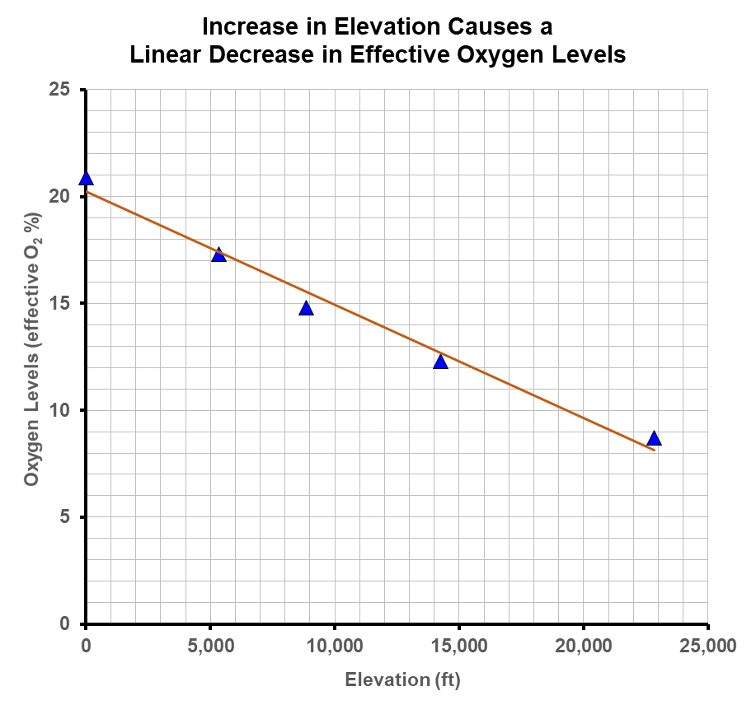
Location | Elevation (ft) | Effective O₂ (%) | Type of Prediction
Mont Blanc, Franco-Italian border | 15,781 | 12.54 | I
Kilimanjaro, Tanzania | 19,341 | 10.65 | I
Denali, Alaska | 20,308 | 10.14 | I
Mt. Everest, Sino-Nepalese border | 29,029 | 5.51 | E

