Slide 1
Graphing

Slide 2
Graphing, Part 1
Write this in your notes
SWBAT read graphs and make conclusions about the relationships between variables

Slide 3
The Scientific Method
REVIEW
This unit will cover some basic skills you will need in chemistry this year
Measurement
Significant Digits
Units
Dimensional Analysis
Scientific Notation
Graphing
Part 1

Slide 4
What is a Graph?
Write this in your notes
A diagram showing the relationship between two or more variables

Slide 5
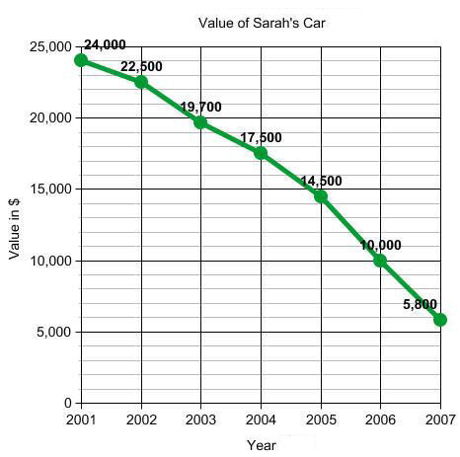
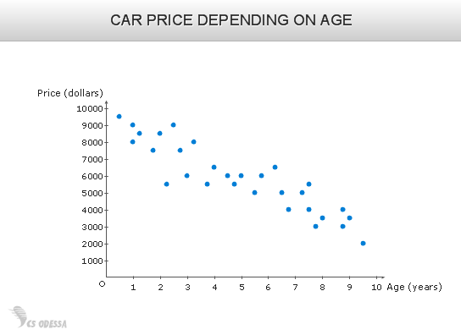
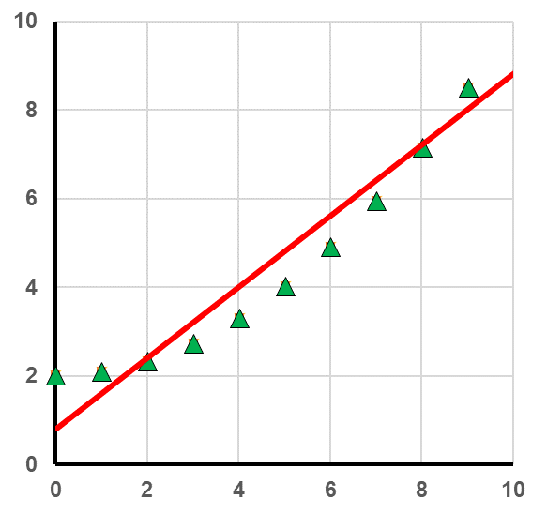
Line & Scatter Plots
line graph
scatter plot
scatter plot
with best fit line
Many types of graphs can be made
In chemistry, we will focus primarily on line and scatter plots

Slide 6
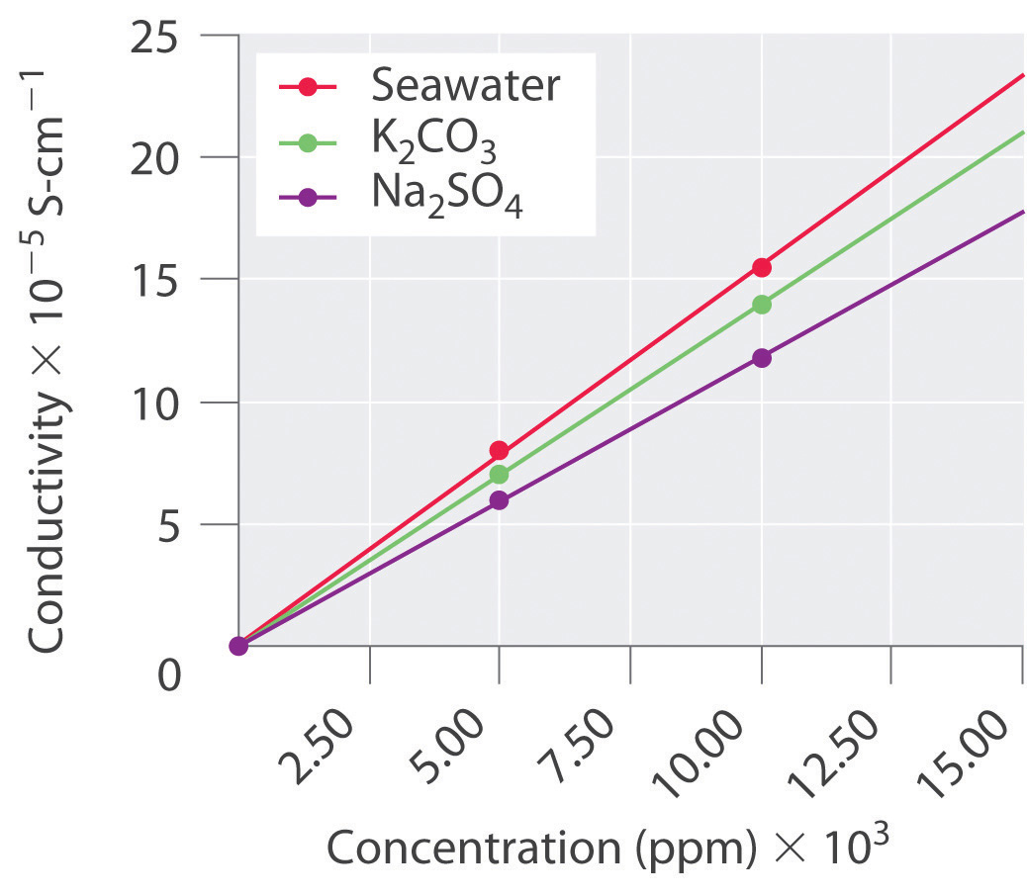
Variable Position On Graphs
Write the RED in your notes
Dependent Variable
Changes because of the independent variable changed
Plotted on the y-axis
The cause and effect relationship is indicated by the position of the variables
Independent Variable
Causes the change
Plotted on the x-axis

Slide 7
What Kind of Relationships?
Broadly speaking, there are 3 types of found
Write this in your notes
Positive
Relationship
Negative
Relationship
No
Relationship
x goes up
y goes up
x goes up
y goes down
x goes up
y doesn’t
change

Slide 8
Line Shapes
The relationships between variables can often by described by a mathematical equation
These produce distinctive line shapes

Slide 9
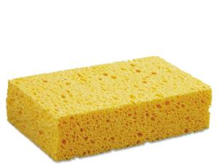

Slide 10
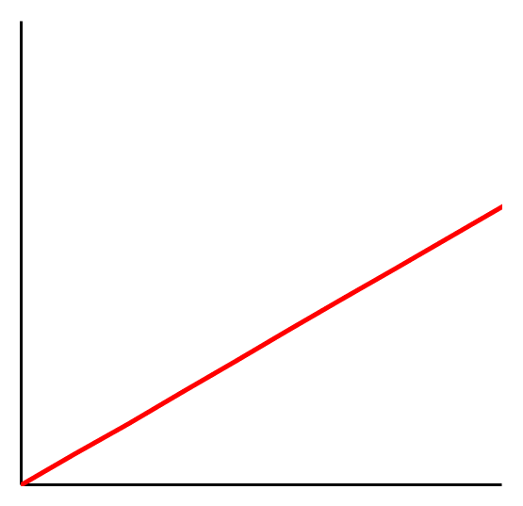
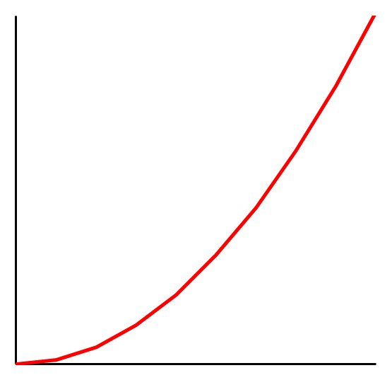
What Kind of Line Shapes?
Broadly speaking, there are 3 types of found
Say “popcorn” if you read this
Linear
Non-Linear
y ~ x^{n}
n = 1
y ~ x^{n}
n ≠ 1

Slide 11
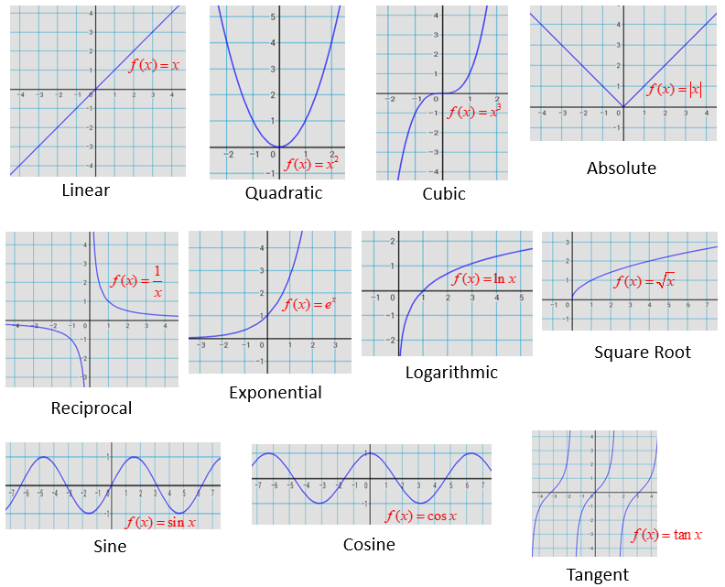

Slide 12
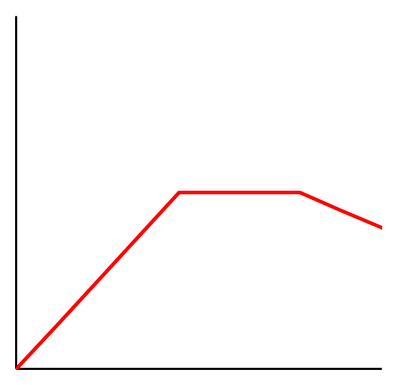
What Kind of Line Shapes?
Broadly speaking, there are 3 types of found
Write this in your notes
Linear
Non-Linear
Discontinuous
y ~ x^{n}
n = 1
y ~ x^{n}
n ≠ 1
relationship
changes as
x changes

Slide 13
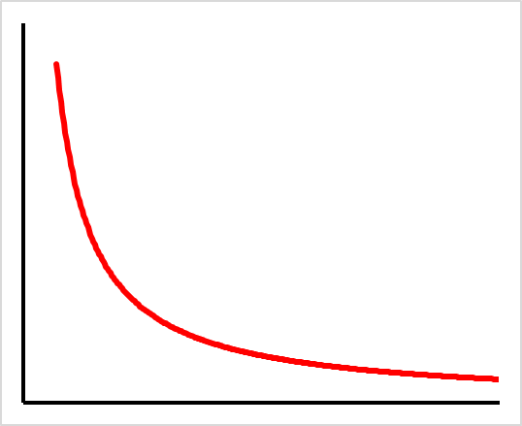
Check for Understanding 1
What kind of graph is this:
line graph
The independent variable is on:
x axis
y axis
The relationship is:
positive
negative
none
The line shape is:
linear
non-linear
discontinuous

Slide 14
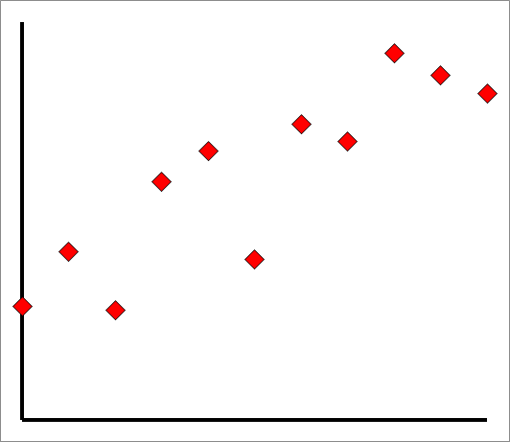
Check for Understanding 2
What kind of graph is this?
scatter plot
The relationship is:
positive
negative
none
The line shape is:
linear
non-linear
discontinuous
The dependent variable is on:
x axis
y axis

Slide 15
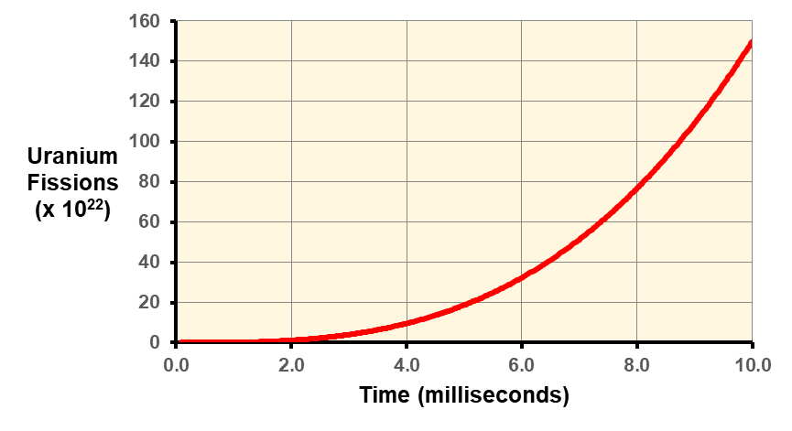
Check for Understanding 3
Graphs show the relationships between variables. In one sentence, describe the relationship shown above.
Increase in time results in a non-linear increase in uranium fissions

Slide 16
Quantitative Analysis & Prediction
Best fit line & goodness of fit
Slope
Interpolation and extrapolation

Slide 17
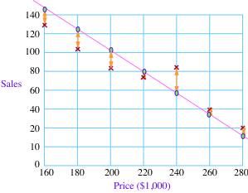
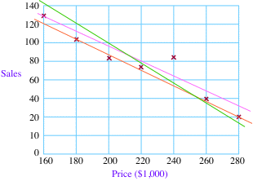
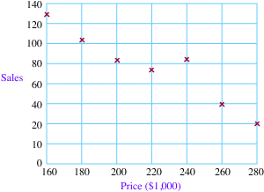
Regression Analysis
Statistical method for finding the mathematical relationship between two variables
Begins by creating a line that goes through the points
Next, the distance between each point and the line
The distances are added up and sums compared with that of other lines
The line with the lowest sum is called the “best fit line”
We will learn how to do regression analysis on Google Sheets

Slide 18
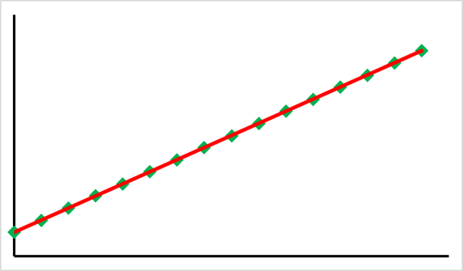
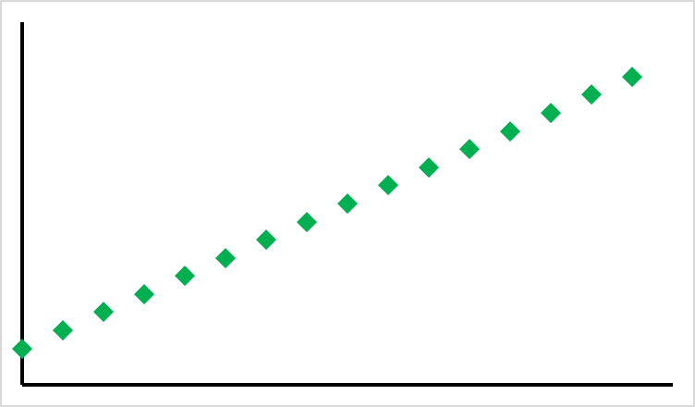
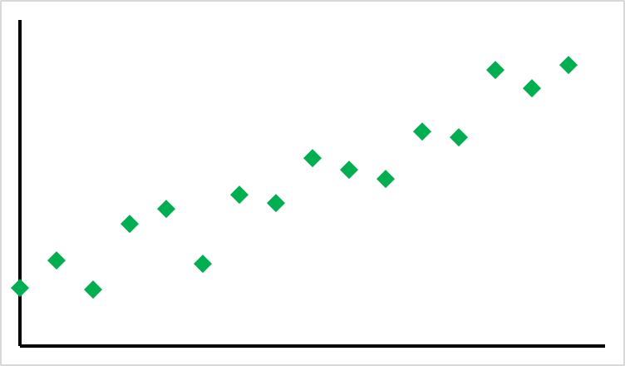
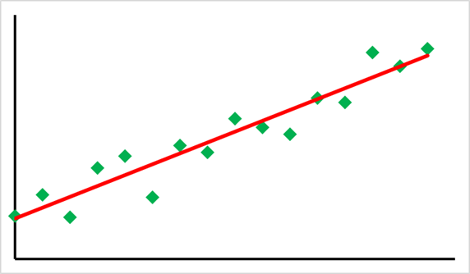
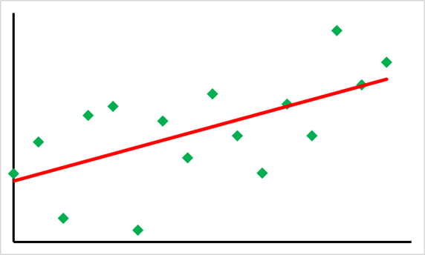
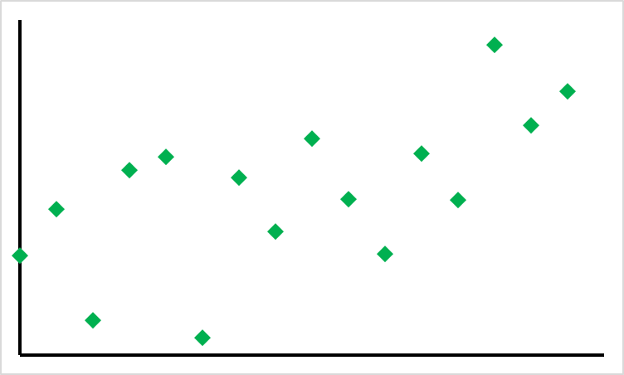
Best Fit Line & Goodness of Fit
R² = 1.00
Regression analysis will find the best fit line
Line that best represents the relationship between the variables
Goodness of fit (R²) shows how well the best fit line explains the data
1.00 – perfect fit
0.91 – good fit
0.38 – bad fit
R² = 0.91
R² = 0.38

Slide 19
Definitions
Write this in your notes
Regression Analysis
Statistical method for finding the mathematical relationship between two variables
Best Fit Line
Line that best represents the relationship between the variables
Goodness of Fit (R²)
Shows how well the best fit line explains the data

Slide 20
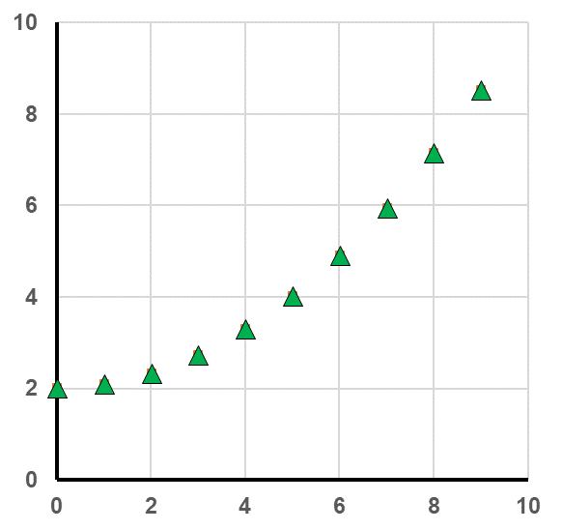
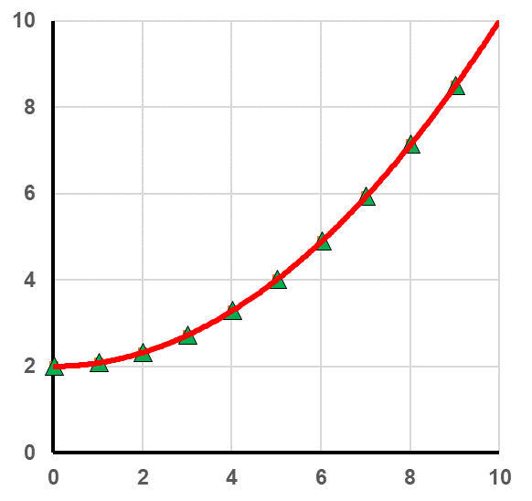
Check for Understanding 4
Which “best fit line” is the best?
R² = 0.93
(linear)
R² = 1.00
(polynomial)
How could we prove it?

Slide 21
Quantitative Analysis & Prediction
Best fit line & goodness of fit
Slope
Interpolation and extrapolation

Slide 22
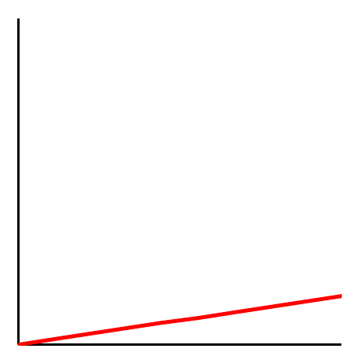
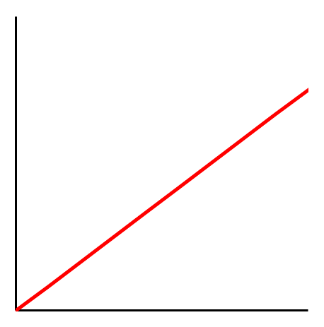
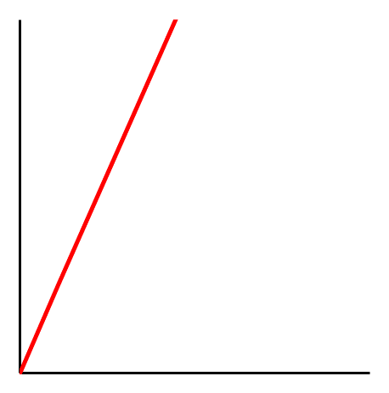
Slopes
The strength of a relationship between two variables is shown by the slope of the line
The relationship is strong if y changes a lot with a little change in x
WEAKER STRONGER

Slide 23
Slopes
The strength of a relationship between two variables is shown by the slope of the line
The relationship is strong if y changes a lot with a little change in x
Thus: large slope = strong relationship
On a graph, determine slope using y = mx + b
Write this in
your notes
If you don’t know this equation, then write this in your notes

Slide 24
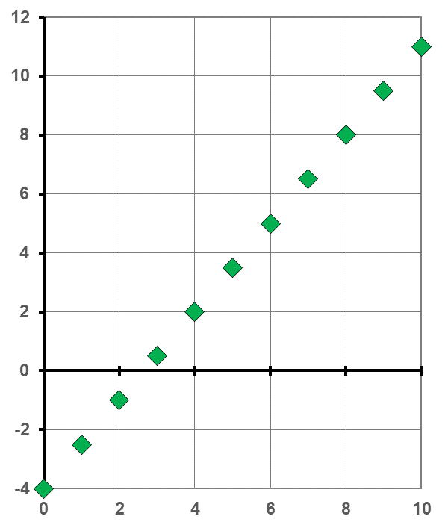
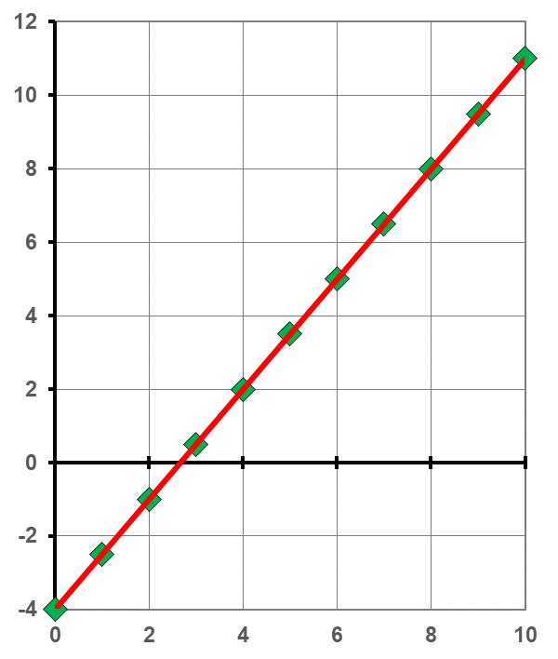
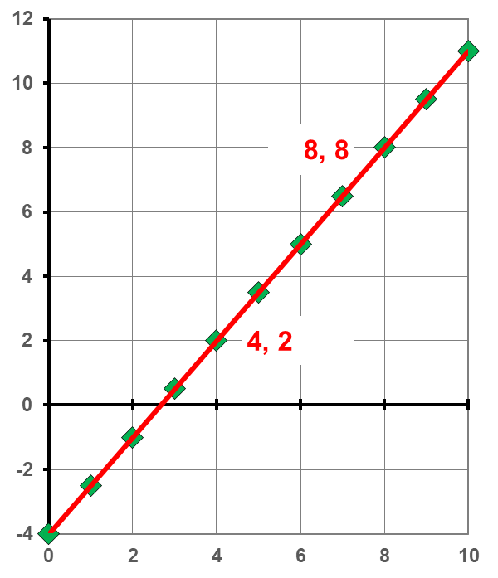
Calculate Slope & Equation
Run a regression analysis to get your best fit line
Pick two points
Use the formula to get slope
Find the y-intercept
– 4
Write full equation
y = 1.5x – 4
y₂ – y₁ | = | 8 – 2 | = | 1.5
x₂ – x₁ |  | 8 – 4

Slide 25
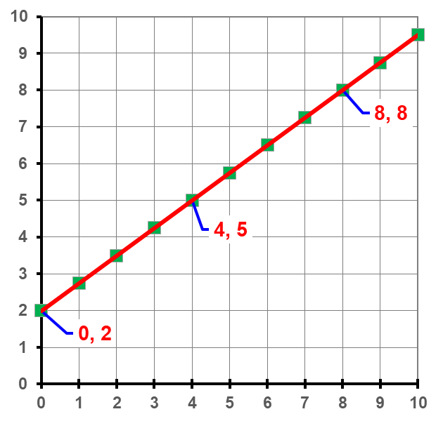
Check for Understanding 5
Calculate the slope
Write the y-intercept
2
Write full equation
y = 0.75x + 2
y₂ – y₁ | = | 8 – 5
x₂ – x₁ |  | 8 – 4
 | = | 0.75

Slide 26
Quantitative Analysis & Prediction
Best fit line & goodness of fit
Slope
Interpolation and extrapolation

Slide 27
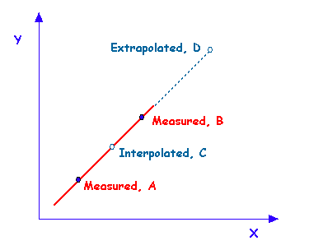
Interpolation & Extrapolation
With a good line, we can predict the x and y values for points not actually measured
Write this in your notes
Interpolation
predictions made between two measured points
Extrapolation
predictions made beyond any measured points

Slide 28
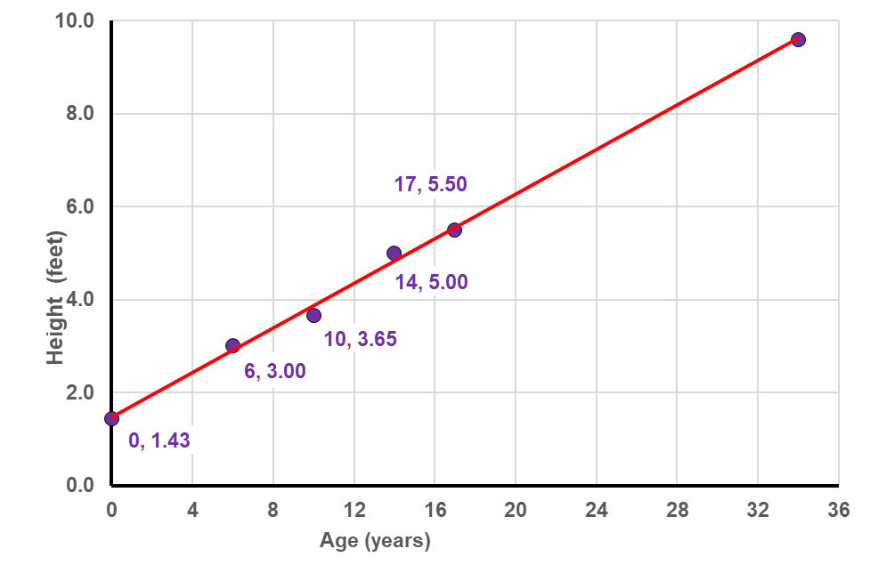
Bryan’s Height over Time
Use his height at birth & 17 to figure the slope
0.239 ft/year
Write the equation for the line
y = 0.239x + 1.43
Interpolate Bryan’s height at 4 years old
2.39 ft
Extrapolate Bryan’s height at 20 years old
6.21 ft, 6’3”
5.50 – 1.43 | = | 0.239
17 – 0
y = 0.239(4) + 1.43
= 2.386
y = 0.239(20) + 1.43
= 6.210

Slide 29
Now Predict Bryan’s Height at 34
y = 0.239(34) + 1.43
= 9.556
Do you believe Bryan will be 9 feet, 7 inches?
The true line flattens out after 20 (discontinuous)
Be careful with extrapolations

Slide 30
Back-Up Slides

Slide 31
Purpose of Graphs
Show relationships between variables
Detect relationships between variables
Predict results

Slide 32
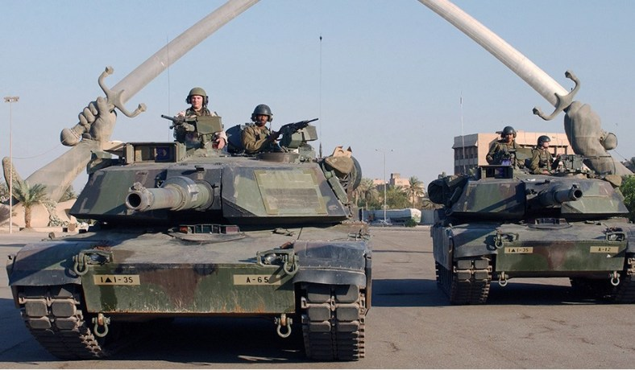
Show Relationships
Two US M1 Abrams tanks pass
under The Swords of Qādisīyah
Baghdad, 2003

Slide 33
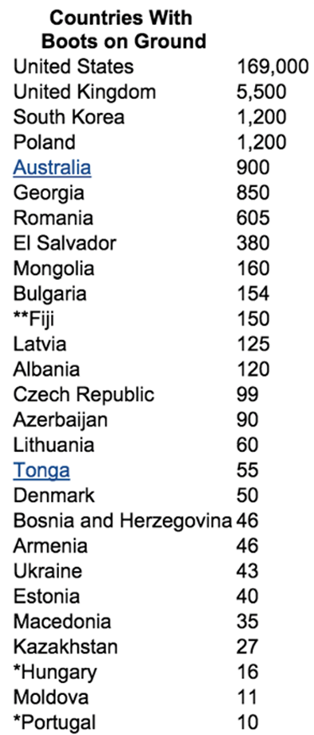
Show Relationships

Slide 34
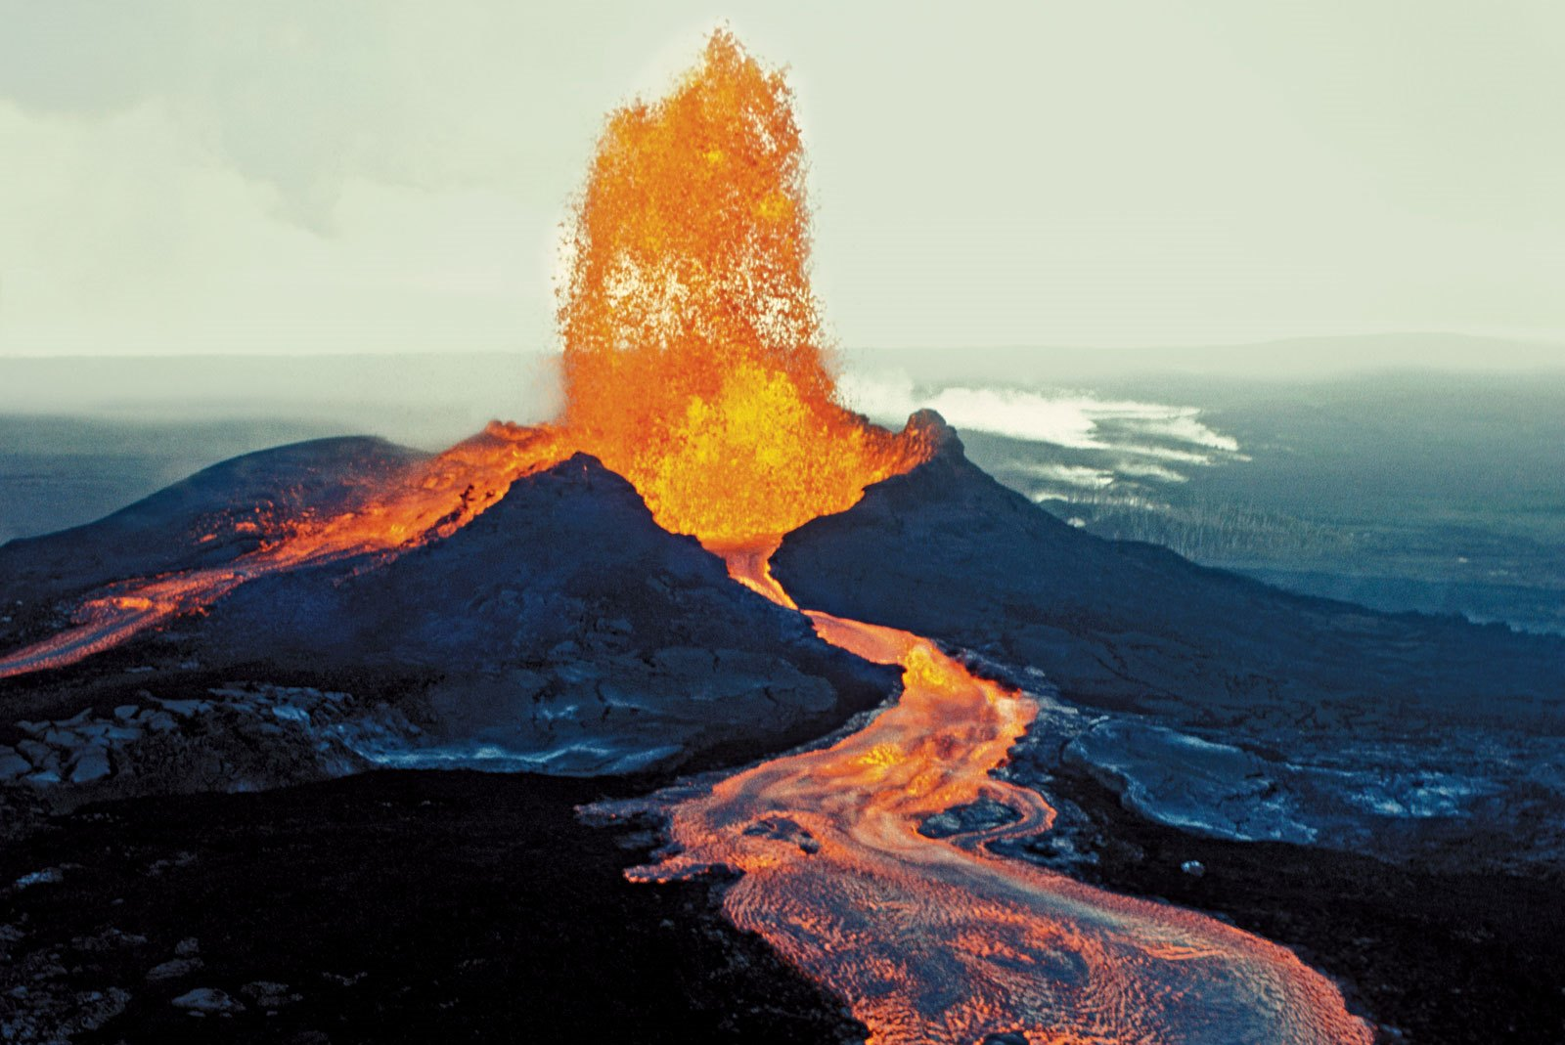
Detect Relationships
Mona Loa, Hawaii,
1984 Eruption
Kilauea erupted
in May, 2018

Slide 35
Detect Relationships

Slide 36
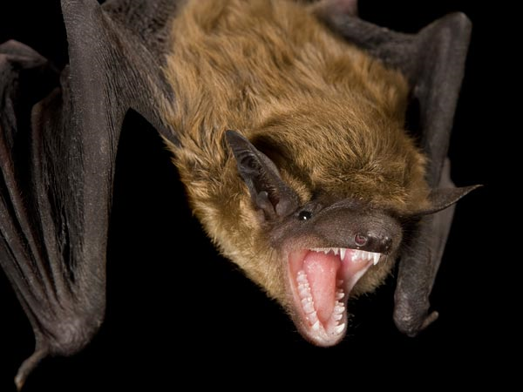
Predict Results
In December, 2013, 2 year old Emile Ouamouno was bitten by an Angolan free-tailed bat outside his home
The bat was carrying Ebola virus
Four days later, Emile was dead
Within a month, his mother, sister and grandmother were all dead
By March, more than 70 people were dead and the number of people infected was doubling every 25 days
Médecins Sans Frontières declares the outbreak “totally out of control”

Slide 37
By late summer, Ebola cases had reached other parts of Africa, most of Europe and the United States with deaths soon to follow

Slide 38
Researchers graphed the existing deaths and predicted an exponential increase in future deaths
world population by early 2016
100 million by fall 2015
1 million by mid 2015
10,000 by end of 2014
Recognizing the threat, nations mobilized resources to battle the epidemic
More than 11,000 were killed, but the epidemic was stopped by mid-2016

Slide 39
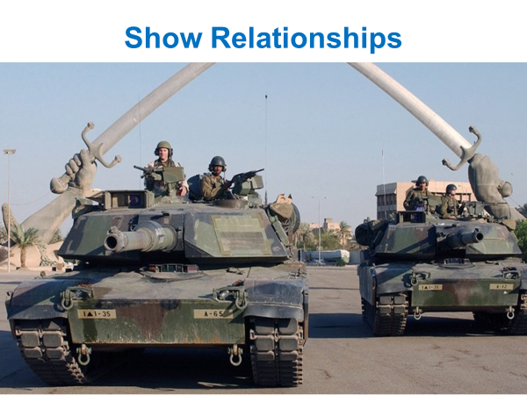
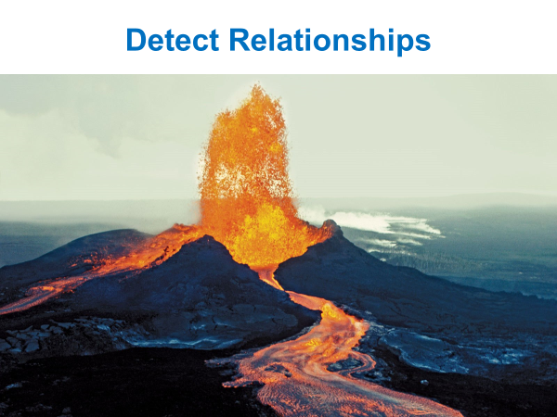
Purpose of Graphs
Show relationships between variables
Detect relationships between variables
Predict results

Slide 40
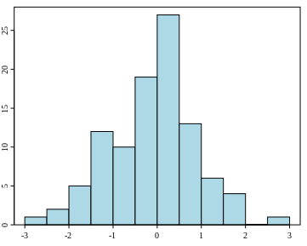
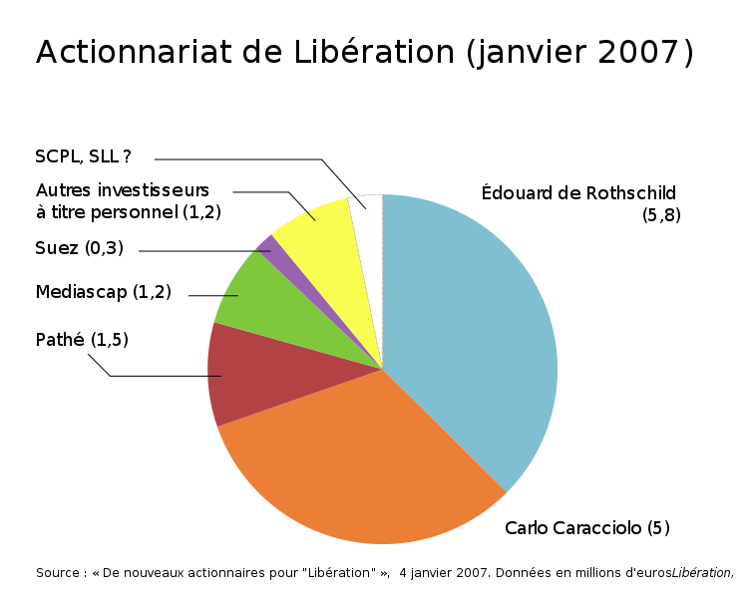
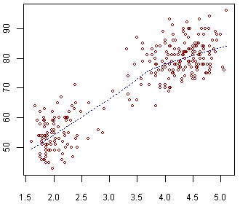
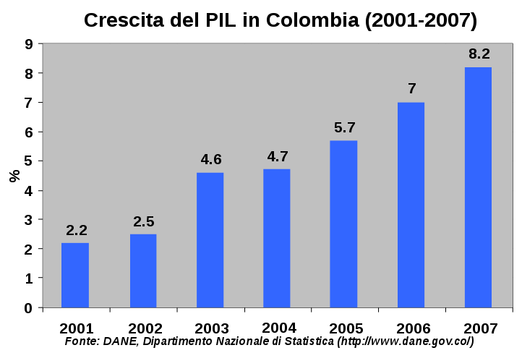
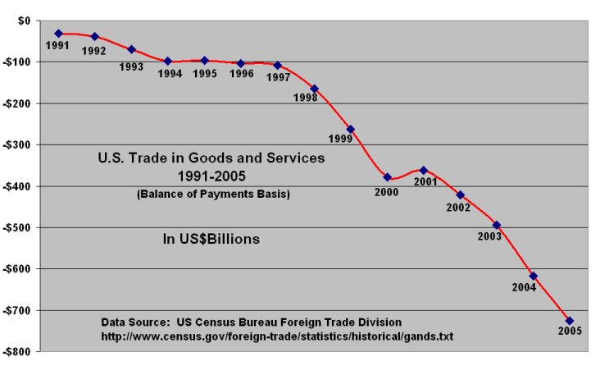
Common Types of Graphs/Charts
histogram
pie
scatter
bar
line

