Slide 1
Units

Slide 2
The Scientific Method
REVIEW
This unit will cover some basic skills you will need in chemistry this year
Measurement
Significant Digits
Units
Dimensional Analysis
Scientific Notation
Graphing

Slide 3
Units
In science, it is important to specify the units being used for a measurement
mass of ammonium sulfate = 14.2
14.2 what?
14.2 grams, 14.2 lbs, what?
14.2 lbs = 6,441 grams
You are expected to use units throughout this course

Slide 4
Metric Prefixes for Magnitude
Prefix | Symbol | Power
giga | G | 10⁹
mega | M | 10⁶
kilo | k | 10³
hecto | h | 10²
deca | da | 10¹
unit | - - - | 10⁰
deci | d | 10^{–1}
centi | c | 10^{–2}
milli | m | 10^{–3}
micro | μ | 10^{–6}
nano | n | 10^{–9}
You are also expected to be able to use these prefixes

Slide 5
Hand Out Units Reference Sheet

Slide 6
Reference Sheet
You will get some reference sheets over the year
These are meant to reduce memorization
You will be allowed to use them in class and during every quiz, test and even the final exam
Please do not write on your reference sheets
You are expected have your reference sheets with you, and to know how to use them

Slide 7
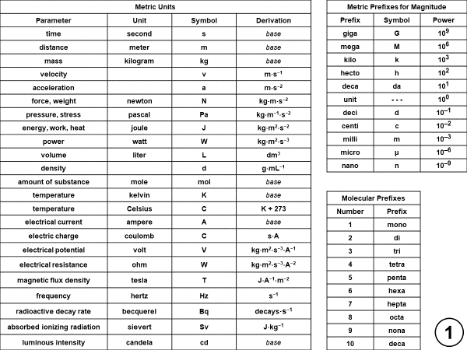
Units Reference Sheet, Side 1

Slide 8
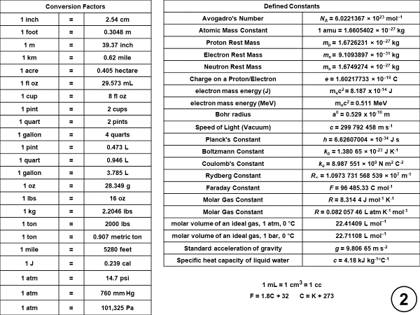
Units Reference Sheet, Side 2

Slide 9
Check for Understanding
What are the units we will use for density?
g/mL
How many watts in a MW? What does it measure?
one million watts, measures power
How many miles in 1km?
0.62 mile
What is the speed of light?
In a vacuum, it is 299,792,458 m/s
What is Avogadro’s number?
6.0221367 x 10²³ per mole

Slide 10
Quiz
There will be no specific quiz question on units
But, later quizzes will require you to use your units reference sheet, so be ready

Slide 11
Metric Units
Parameter | Unit | Symbol | Derivation
time | second | s | base
distance | meter | m | base
mass | kilogram | kg | base
velocity |  | v | m⋅s⁻¹
acceleration |  | a | m⋅s⁻²
force, weight | newton | N | kg⋅m⋅s⁻²
pressure, stress | pascal | Pa | kg⋅m⁻¹⋅s⁻²
energy, work, heat | joule | J | kg⋅m²⋅s⁻²
power | watt | W | kg⋅m²⋅s⁻³
volume | liter | L | dm³
density |  | d | g⋅mL⁻¹
amount of substance | mole | mol | base
temperature | kelvin | K | base
temperature | Celsius | C | K + 273
electrical current | ampere | A | base
electric charge | coulomb | C | s⋅A
electrical potential | volt | V | kg⋅m²⋅s⁻³⋅A⁻¹
electrical resistance | ohm | W | kg⋅m²⋅s⁻³⋅A⁻²
magnetic flux density | tesla | T | J⋅A⁻¹⋅m⁻²
frequency | hertz | Hz | s⁻¹
radioactive decay rate | becquerel | Bq | decays⋅s⁻¹
absorbed ionizing radiation | sievert | Sv | J⋅kg⁻¹
luminous intensity | candela | cd | base
Metric Prefixes for Magnitude
Prefix | Symbol | Power
giga | G | 10⁹
mega | M | 10⁶
kilo | k | 10³
hecto | h | 10²
deca | da | 10¹
unit | - - - | 10⁰
deci | d | 10^{–1}
centi | c | 10^{–2}
milli | m | 10^{–3}
micro | μ | 10^{–6}
nano | n | 10^{–9}
Molecular Prefixes
Number | Prefix
1 | mono
2 | di
3 | tri
4 | tetra
5 | penta
6 | hexa
7 | hepta
8 | octa
9 | nona
10 | deca
1

Slide 12
Conversion Factors
1 inch | = | 2.54 cm
1 foot | = | 0.3048 m
1 m | = | 39.37 inch
1 km | = | 0.62 mile
1 acre | = | 0.405 hectare
1 fl oz | = | 29.573 mL
1 cup | = | 8 fl oz
1 pint | = | 2 cups
1 quart | = | 2 pints
1 gallon | = | 4 quarts
1 pint | = | 0.473 L
1 quart | = | 0.946 L
1 gallon | = | 3.785 L
1 oz | = | 28.349 g
1 lbs | = | 16 oz
1 kg | = | 2.2046 lbs
1 ton | = | 2000 lbs
1 ton | = | 0.907 metric ton
1 mile | = | 5280 feet
1 J | = | 0.239 cal
1 atm | = | 14.7 psi
1 atm | = | 760 mm Hg
1 atm | = | 101,325 Pa
Defined Constants
Avogadro's Number | N_{A} = 6.0221367 × 10²³ mol⁻¹
Atomic Mass Constant | 1 amu = 1.6605402 × 10⁻²⁷ kg
Proton Rest Mass | m_{p} = 1.6726231 × 10⁻²⁷ kg
Electron Rest Mass | m_{e} = 9.1093897 × 10⁻³¹ kg
Neutron Rest Mass | m_{n} = 1.6749274 × 10⁻²⁷ kg
Charge on a Proton/Electron | e = 1.60217733 × 10⁻¹⁹ C
electron mass energy (J) | m_{e}c² = 8.187 x 10⁻¹⁴ J
electron mass energy (MeV) | m_{e}c² = 0.511 MeV
Bohr radius | a⁰ = 0.529 x 10⁻¹⁰ m
Speed of Light (Vacuum) | c = 299 792 458 m s⁻¹
Planck's Constant | h = 6.62607004 × 10⁻³⁴ J s
Boltzmann Constant | k_{b} = 1.380 65 × 10⁻²³ J K⁻¹
Coulomb's Constant | k_{e} = 8.987 551 × 10⁹ N m² C⁻²
Rydberg Constant | R∞ = 1.0973 731 568 539 × 10⁷ m⁻¹
Faraday Constant | F = 96 485.33 C mol⁻¹
Molar Gas Constant | R = 8.314 4 J mol⁻¹ K⁻¹
Molar Gas Constant | R = 0.082 057 46 L atm K⁻¹ mol⁻¹
molar volume of an ideal gas, 1 atm, 0 °C | 22.41409 L mol^{–1}
molar volume of an ideal gas, 1 bar, 0 °C | 22.71108 L mol^{–1}
Standard acceleration of gravity | g = 9.806 65 m s⁻²
Specific heat capacity of liquid water | c = 4.18 kJ kg⁻¹°C⁻¹
1 mL = 1 cm³ = 1 cc
F = 1.8C + 32 C = K + 273
2

