Slide 1
Please Sit in Your Assigned Seat

Slide 2
Today's Class
Typical Lesson & Unit
Grading Policies
Student Responsibilities
Class Rules and Procedures

Slide 3
Typical Lesson

Slide 4
Start of Lesson
Do Now
Announcements
Objective

Slide 5
Lesson Objective
The title on the objective slide ...
... is the same as name on website file

Slide 6
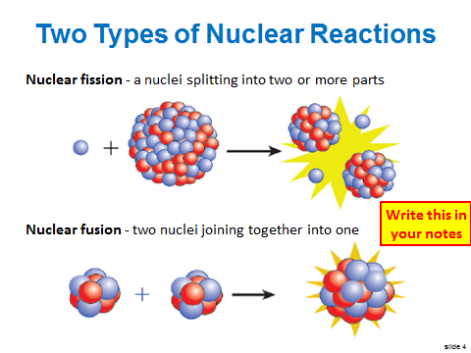
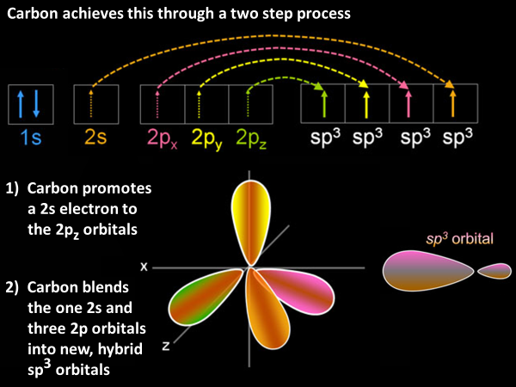
Introduction of New Material
The new concepts are taught here
This usually takes
only 10-15 minutes
Don’t miss this part

Slide 7
Use the New Material
Most of class time is spent here
“I do, we do, you do” method
Don’t skip these problems

Slide 8
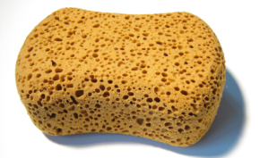
Messages on Slides
Write this in your notes
This message means the material on the slide is very important
When you see this, write the material in your notes
You can be tested on anything, but >90% of test questions will be on “write this in your notes”
This message means this is “write this in your notes” material that should have been written previously
The sponge means you should simply watch the presentation and absorb . . .
absorb like a sponge . . .
get it? see what I did there?
pretty clever huh?
not impressed? I’d like to see you do better!
I try to make this fun and all I get is flak
I can’t believe you are still trying to read this because it is just a joke & very small
REVIEW

Slide 9
Typical Unit

Slide 10
Typical Week of a Unit
Monday: Start lesson 1
Tuesday: Finish lesson 1, start lesson 2
Thursday: Finish lesson 2, start lesson 3
Friday: Quizzes on lessons 1 & 2, finish lesson 3

Slide 11
Typical Unit
Week 1: Lessons 1-3, quizzes 1-2
Week 2: Lessons 4-5, quizzes 3-4
Week 3: Lessons 6-7, quizzes 5-7
Week 4: Pre-lab, lab experiment
Week 5: Cold Call, Test, start next unit

Slide 12
Units
Scientific Method
Atomic Theory
Nuclear Chemistry
The Mole
Electrons
Periodic Properties
Bonding
Covalent Bonding
Nomenclature
Chemical Reactions
Stoichiometry

Slide 13
Grading Policies

Slide 14
Course Grade
Write this in your notes
1st Quarter | 20%
2nd Quarter | 20%
3rd Quarter | 20%
4th Quarter | 20%
Final Exam | 20%

Slide 15
Final Exam Policy
The final exam counts for 20% of your course grade
A student can be excused from the final exam if they have a high enough average grade at the end of 4Q
Underclassmen: 93 or above*
Seniors: 90 or above*
You really want to get out of this final!!!
* PowerSchool grade for Y1 after all grades have been finalized

Slide 16
Quarter Grade
Write this in your notes
Tests | 40%
Lab Reports | 30%
Quizzes/Assignments | 20%
Participation | 10%

Slide 17
Tests
One hour, in-class summary assessment
Covers the entire unit
As necessary, will include items learned in previous units
Test are the biggest factor in your course grade
Usually 2-3 per quarter
Generally regarded as “hard” tests
Studying is required to do well
Write this in your notes

Slide 18
Lab Reports
Written summary of lab experiments
Outline of expectations provided
One report per lab team (2-3 students)
Submitted through Google Classroom
Four lab reports per year
Relatively easy but takes time
Don’t be late or you’ll lose points
(10% penalty per day late)
Write this in your notes

Slide 19
Quizzes/Assignments
You will have very little homework, but . . .
You will have a quiz every Friday on all new material
Each quiz question is worth 10 points
You should do fine if you:
pay attention in class
do all practice problems
refresh you memory Friday
Although quizzes count for 20% of your grade, use this to monitor how you are doing and seek help if your are having issues
Write this in your notes

Slide 20
Participation
As a student, you have a job to do every day
Participation grades how well you attend to your responsibilities as a student
Worth 10% of quarter grade
Key elements:
Are you focused on the lesson?
Are you doing all the practice problems?
Do you ask for help when needed?
Are you distracted in class?
Are you distracting others in class?
Write this in your notes

Slide 21
Extra Time on Quizzes/Tests
You are expected to complete all quizzes and tests in the time allotted
If you have an extra time accommodation, you must tell me before the test begins
You are not allowed to view test questions, leave the classroom, and later answer the question
You will take one page of the test at a time
If you take a page, you must finish it during that sitting
Write this in your notes
Write this in your notes

Slide 22
Missed Classes
If you miss a class, getting caught up and making up the work is YOUR responsibility.
Ask a reliable friend for the notes and any assignments.
You have a 2 day grace period for quizzes
Write this in your notes
Must
take quiz
Must
take quiz
Can
delay quiz
Can
delay quiz
Monday | Tuesday | Wednesday | Thursday | Friday
Missed
Class
Missed
Class
Missed
Class
Missed
Class
QUIZ

Slide 23
Make-up of Tests & Quizzes
Write this in your notes
You have 2 weeks to make-up any missed work. After that, you will get a zero.
Please note that sports or jobs do not take priority over your school responsibilities
Make-up Times |  | No Make-ups
TESTS ONLY: While class is reviewing test |  | While I am teaching
Department Night |  | Period 9 club
Any DL/ARC I have |  | Planning periods

Slide 24
Student Responsibilities

Slide 25
Get Required Materials
You needs these every day
If you don’t have your calculator, you will take a quiz or test without it!
Write this in your notes
Scientific calculator. Recommended: Ti-30Xa $14. Required functionality: basic arithmetic, floating point and scientific notation, powers, roots, logarithms, reciprocals, pi

Slide 26
Stay Engaged
Stay focused on the lesson during class
Do all the problems assigned
Do not get distracted
If I call for your attention, look at me right away
Write this in your notes

Slide 27
Take Notes
Write this in your notes
You are required to take notes in this class
If you refuse, you will lose participation points
During open note quizzes, you will only be allowed to use your notes

Slide 28
Get Help
Chemistry is a hard subject, but everyone here can succeed in this course.
If you don't understand something, please see me.
Seek help a soon as you realize you need it.
Please see me when I am available to help you.
Please note that I usually can not help you before school or as class is beginning.

Slide 29
Lesson Slides
Lesson slides will be posted on the class website
Sometimes the slides are an older version. If you specifically want the updated version, let me know and I will get it posted.
YOU STILL SHOULD TAKE NOTES
There is no replacement for hearing the lesson
and recording it by hand

Slide 30
Other Rules
Be on time
Expect a full period of class
Sit in your assigned seats
Food and drink
During class, you can eat or drink so long as don't get distracted and don't make a mess
NO FOOD OR DRINK IN THE LABORATORY
Write this
in your
notes

Slide 31
Class Rules and Procedures

Slide 32
Safety
Write this
in your
notes
Safety is our highest priority
Do not do anything unless
you know what you’re doing
you are aware of the risks
you are properly protected
More to come, but always stay safe

Slide 33
Phones
Write this in your notes
Phones are not allowed in class
If I see your phone or see you using your phone, I will tell you to put it in the phone rack
If you refuse, I will write you up and deduct points from your participation grade
Applies to any source of sensory feedback (ear buds, etc)

Slide 34
Bathroom
To use bathroom:
Raise hand and ask
Sign out and take hall pass
Sign in when you return
One student out of the class at a time
Choose the best time to go

Slide 35
Rhode Island College Early Enrollment Program (RIC EEP)
EEP students earn credit for RIC's CHEM 103 while taking SHS's Honors Chemistry
Benefits:
College credits for chemistry
Low cost
Enrollment date & cost to be announced

Slide 36
Any Questions???

Slide 37
Check for Understanding
What is the highest priority in chemistry?
Safety
Keep yourself safe at all times
Don’t endanger anyone else

Slide 38
Check for Understanding
How many days do you have to make up a missed quiz or test? What happens if it is not made up in time?
You have two weeks from the day of the quiz or test to make it up
If it is not made up in time, you will receive a zero

Slide 39
Check for Understanding
What percentage of your grade comes from the final exam?
20

Slide 40
Check for Understanding
What is a "Do Now"? When should you do it?
A "Do Now" is a warm up exercise at the beginning of class
A "Do Now" should be done now!

Slide 41
Check for Understanding
If Dr. McCarthy calls for attention, what should you do?
Immediately stop what you are doing and look at him

Slide 42
Check for Understanding
Why is it valuable to write down the title of each lesson?
The lesson slides are posted on our website and the file name is the same as the lesson title

Slide 43
Check for Understanding
How many warnings will Dr. McCarthy give you about your phone?
None.
If he sees it or he sees you use it, you will be told to put it in the phone rack

Slide 44
Check for Understanding
What should you do when you see a sign which says "Write this in your notes"?
Write the information on the slide in your notes

Slide 45
Check for Understanding
If you are two days late turning in your lab report, how many points will you lose?
20

Slide 46
Check for Understanding
What does the participation grade measure? What is it worth?
The participation grade measures how well you attend to your responsibilities as a student
It is worth 10% of each quarter grade

Slide 47
Check for Understanding
What should you do if you miss a day of class?
Ask a reliable friend for the notes and any assignments

Slide 48
Check for Understanding
You missed class on Wednesday. Are you required to take the quiz on Friday?
No, the grace period is just 2 days

Slide 49
Check for Understanding
What is the procedure for going to the bathroom?
Raise your hand and ask permission
Sign out and take hall pass
Sign back in upon returning

